Slide 1

“E-WEB Creators”
Project Title : “E Web-Creators”
Internal Guide : Prof. Gaurav Patel
Project Guide : Mr. Vasim Shaikh
Project Partners : Sevak Krunal [10B108]
Shah Hemil [10B112]

Slide 2
About the System
It is well known fact that software companies undertake huge projects more than one at a time. Hence there is a profound need for the organizations to manage all the projects efficiently and ensure that projects cycle goes on smoothly and they are completed on time.
E Web-Creators deals with the various levels of project development and will account for time used in phases vise analysis, design, coding, testing and implementation etc.
DESCRIPTION:
E Web-Creators gives the management clear picture of usage of time by projects. By analyzing the results provided by the software they might rectify the defects in utilizing time and take remedial actions.
E Web-Creators takes Task & Project Status reports as input.
E Web-Creators gives the individual report of the project, which contains time used for various tasks.
This project deals with six modules – Admin, Client, Business Development Officer (BDO), Developer (Employee), Human Resource Manager (HR) and Project Manager (PM).

Slide 3
Detailed Description of the System
Existing system:
The current System is very tedious and lengthy.
The current system is manual system.
Most of the clients are concerned with Manual System.
The manual system is time consuming.
There is lots of limitation in the current manual system.
Clients have to wait for the beading of the officials to make their website.
It is hard to take the review of the customer.
It is hard to view the current status of the project.

Slide 4
Proposed system:
Earlier all website created & managed manually, but today it is very difficult task to manage client manually and keep record of them. So, our project provides the facility to manage clients and their details automatically by computer.
when customer have any problem related to changes of requirements then our site provides appropriate response to the client to change his requirements, and stored his changes in a database with his details.
To provide useful and an efficient online requirement for the project.
The need to develop a new system is just to provide better facilities to the H.R. (Administrator).
Even to minimize the workload of the Administration.
To provide faster response to the Client who want to create a website.
Quick generations of the reports.
Visitor will get approval through Email or message.
Provide faster services to client for his changing requirements.
To check project work status day by day.
It provides Login Functionality, Change Password Functionality, and Forgot Password Functionality.

Slide 5
System Documentation
System Flow Chart
Entity Relationship Diagram
Context Diagram
Data Flow Diagram
Data Dictionary
Screen Layouts

Slide 6
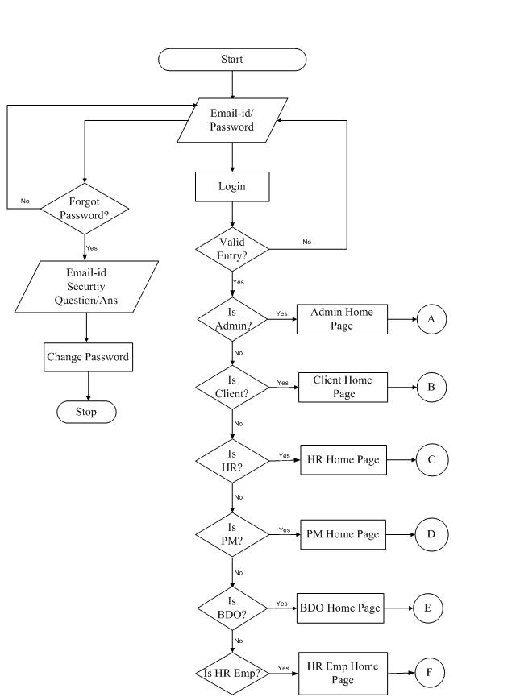
System Flow Chart

Slide 7
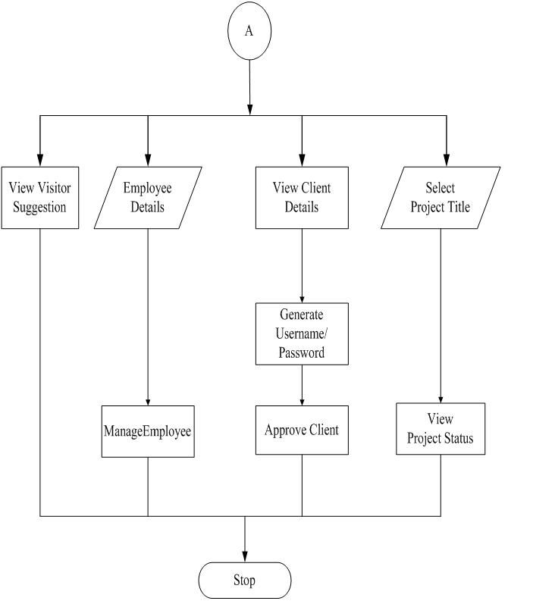
Admin Flow Chart

Slide 8
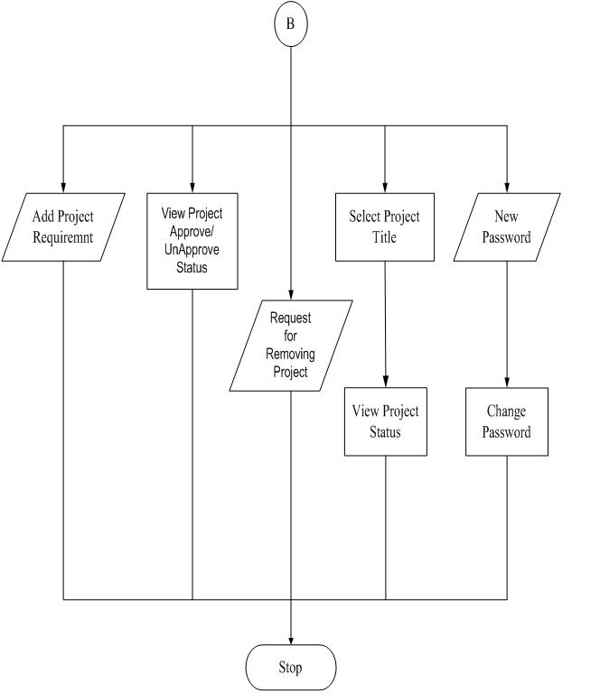
Client Flow Chart

Slide 9
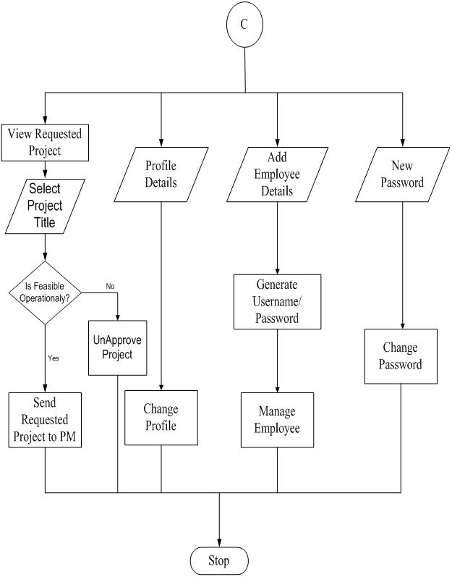
Human Resource Manager

Slide 10
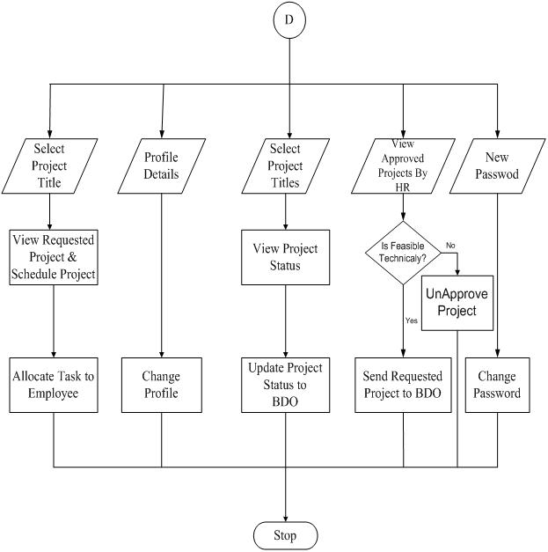
Project Manager

Slide 11
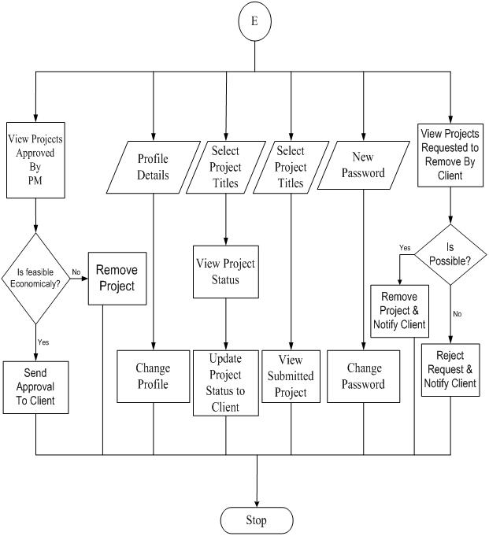
Business Development Officer

Slide 12
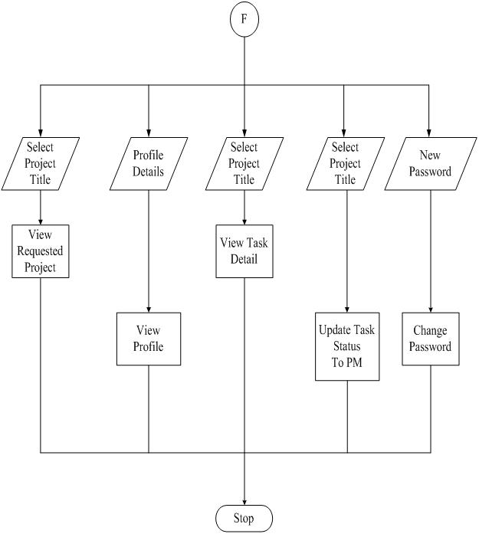
HR-EMP (DEVELOPER)

Slide 13
Entity Relationship Diagram
ERD.docx
Entity – Relationship Diagram: This depicts relationship between data objects. The attribute of each data objects noted in the entity- relationship diagram can be described using a data object description. Data flow diagram serves two purposes:
1. To provide an indication of how data are transformed as they move through the system.
2. To depict the functions that transformation the dataflow.
The object relationship pair can be represented graphically using the Entity Relationship Diagrams. A set of primary components are identified for the Entity Relationship Diagram,
1. Attributes,
2. Relationships and
3. Various Type Indicators.
The primary purpose of the Entity Relationship Diagram is to represent data objects and their relationships.

Slide 14
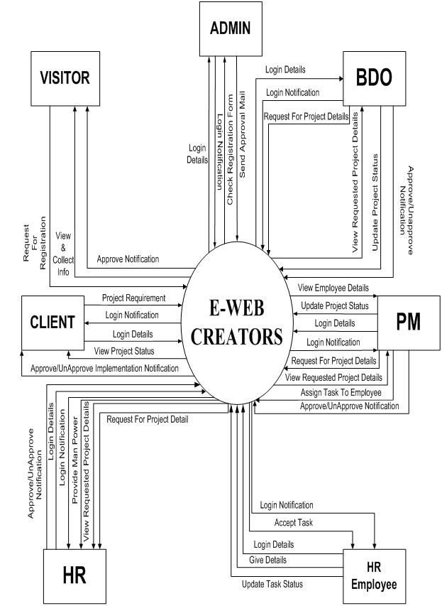
Context Diagram

Slide 15
Data Flow Diagram
DFD.docx
The DFD is a diagram that shows how the data manipulated by a system flows through the various processes. You'll see one of several types of symbols in a DFD... a process, a data store, or an external entity. These symbols are connected by arrowed lines showing how the data moves from a data store or external entity, through a process, and back to a data store or external entity.

Slide 16
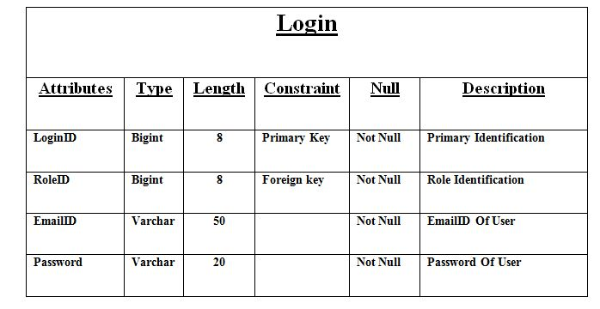
Data Dictionary

Slide 17
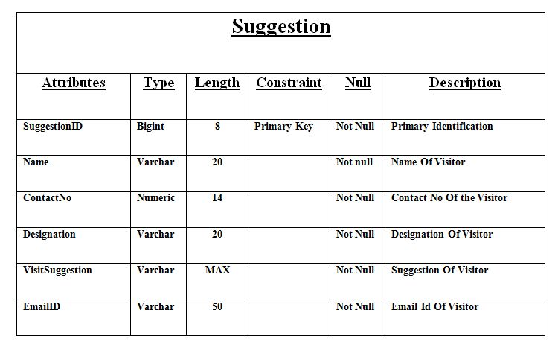
Cont…..

Slide 18
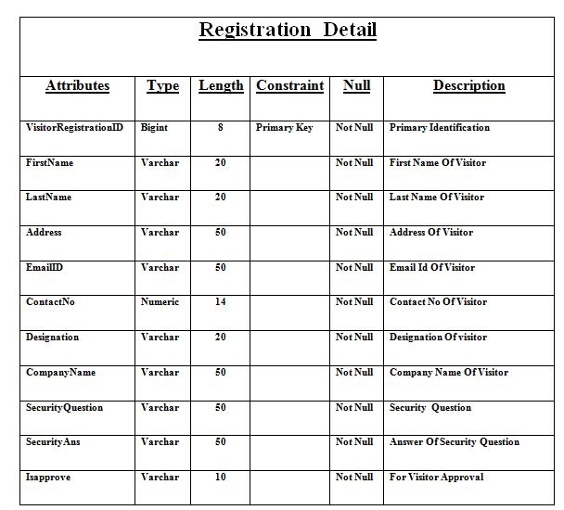

Slide 19
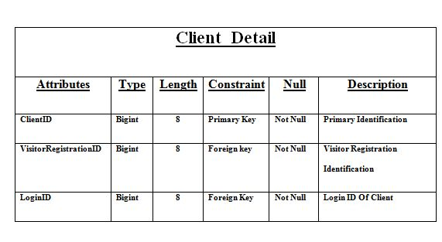
Cont…..

Slide 20
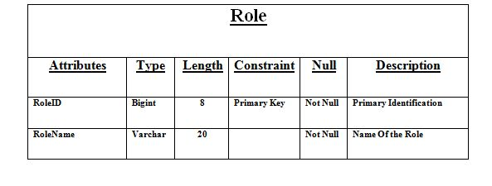
Cont…..

Slide 21
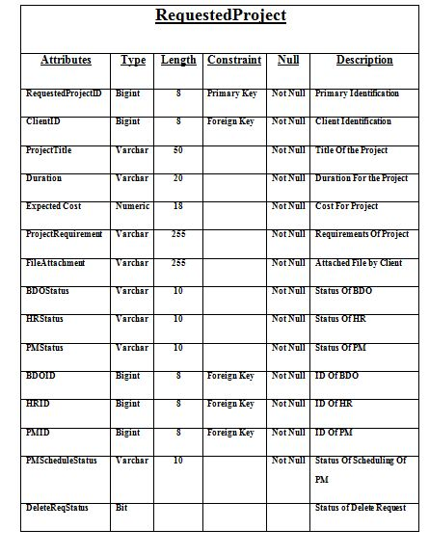

Slide 22
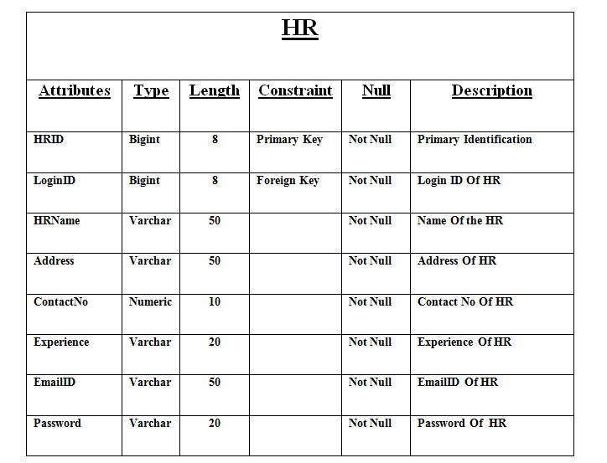
Cont…..

Slide 23
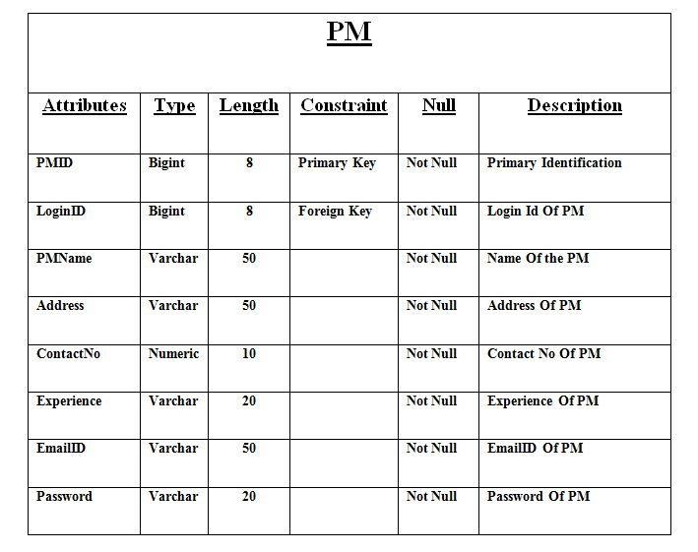
Cont…..

Slide 24
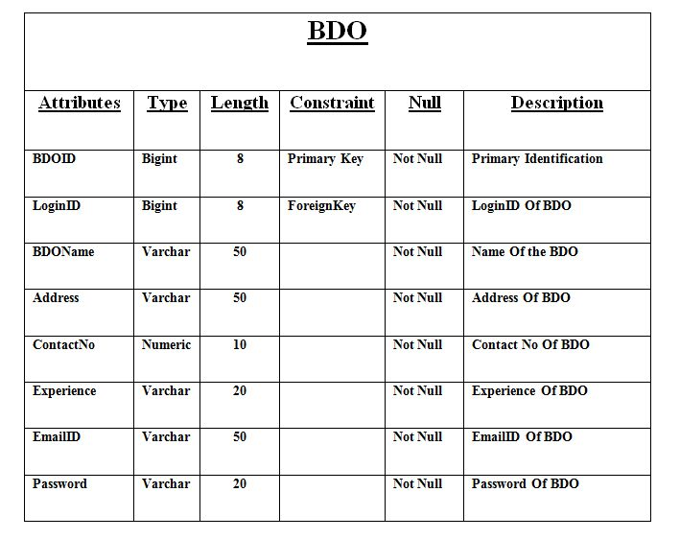
Cont…..

Slide 25
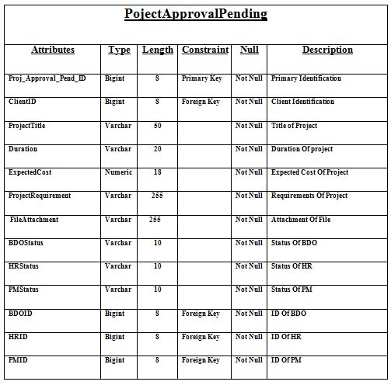

Slide 26
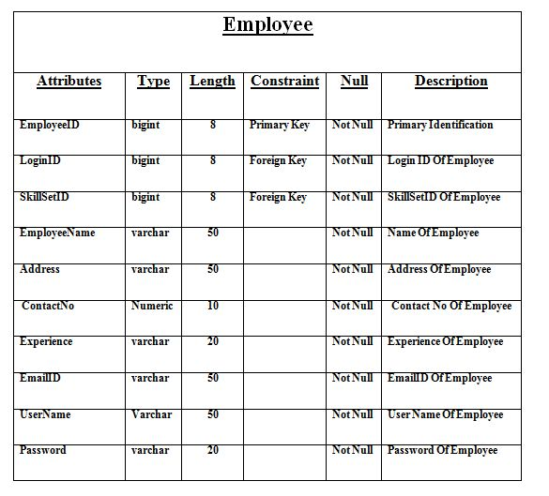
Cont…..

Slide 27
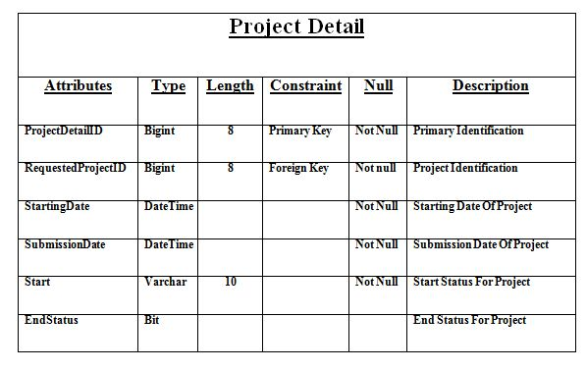
Cont…..

Slide 28
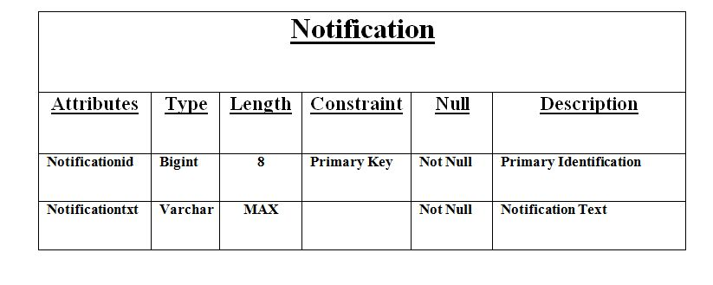
Cont…..

Slide 29
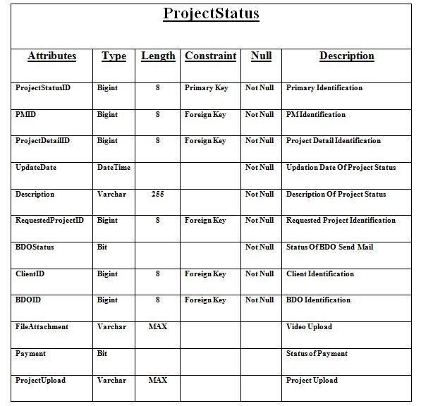

Slide 30
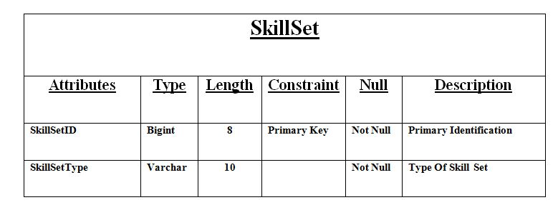
Cont…..

Slide 31
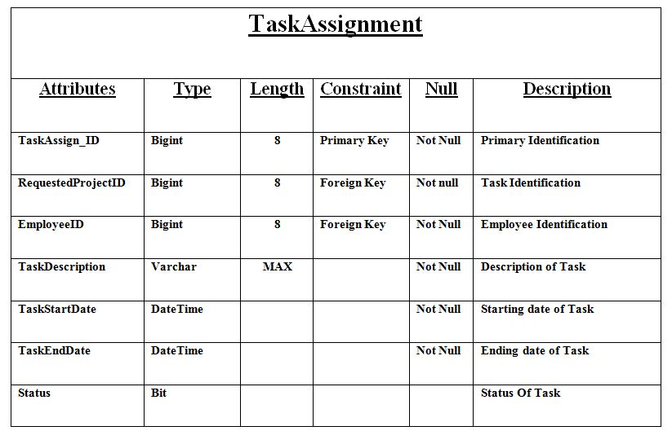
Cont…..

Slide 32
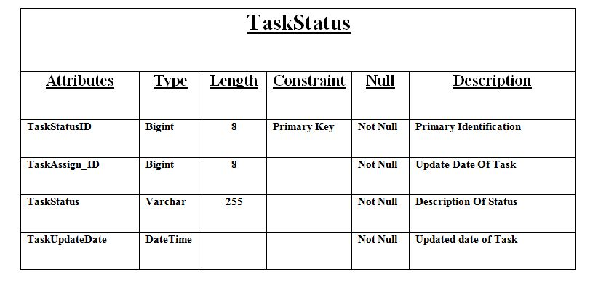
Cont…..

Slide 33
SCREEN LAYOUTS
Visitor
Admin
Client
Human Resource Manager
Project Manager
Business Development Officer
HR-Employee(Developer)
Reports

Slide 34
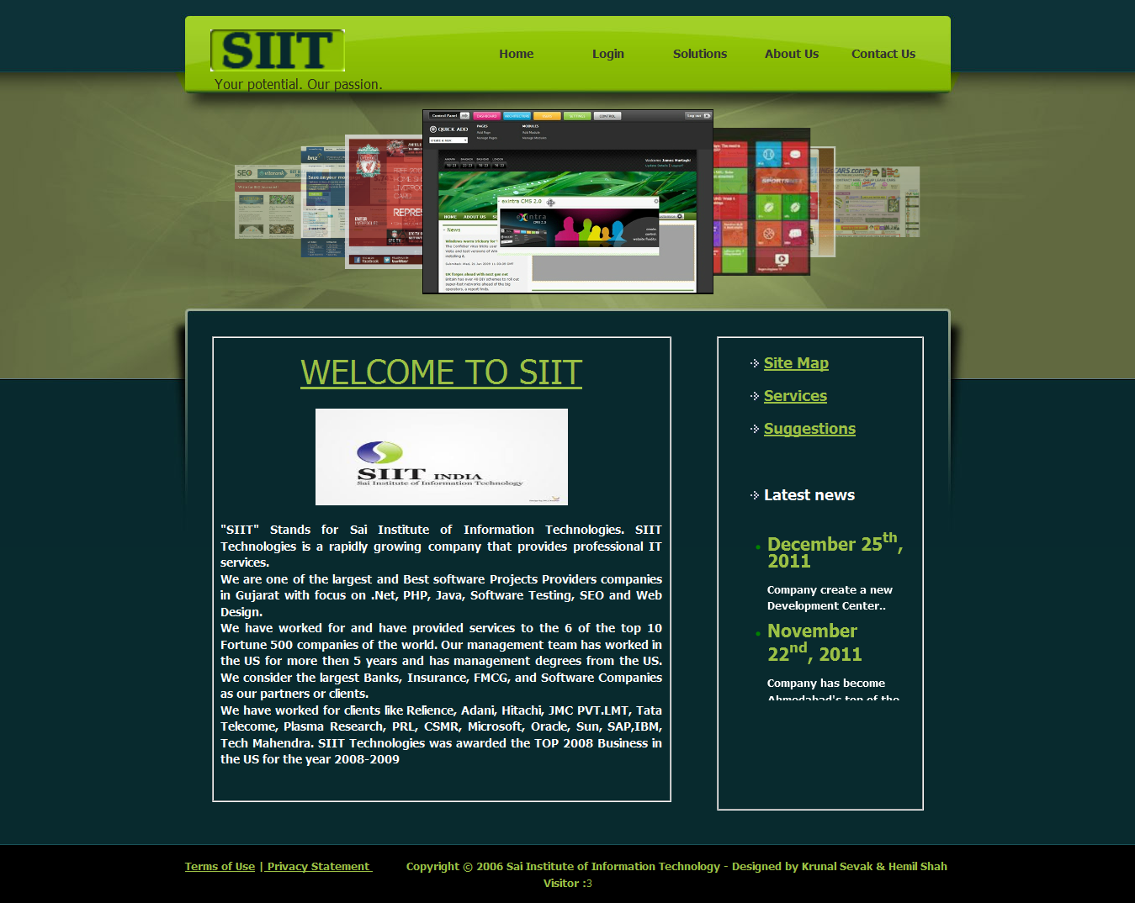
HOME PAGE
This page is website’s Home Page. In this page number of users are counted.
Whenever this website will be open this page will be displayed first.

Slide 35
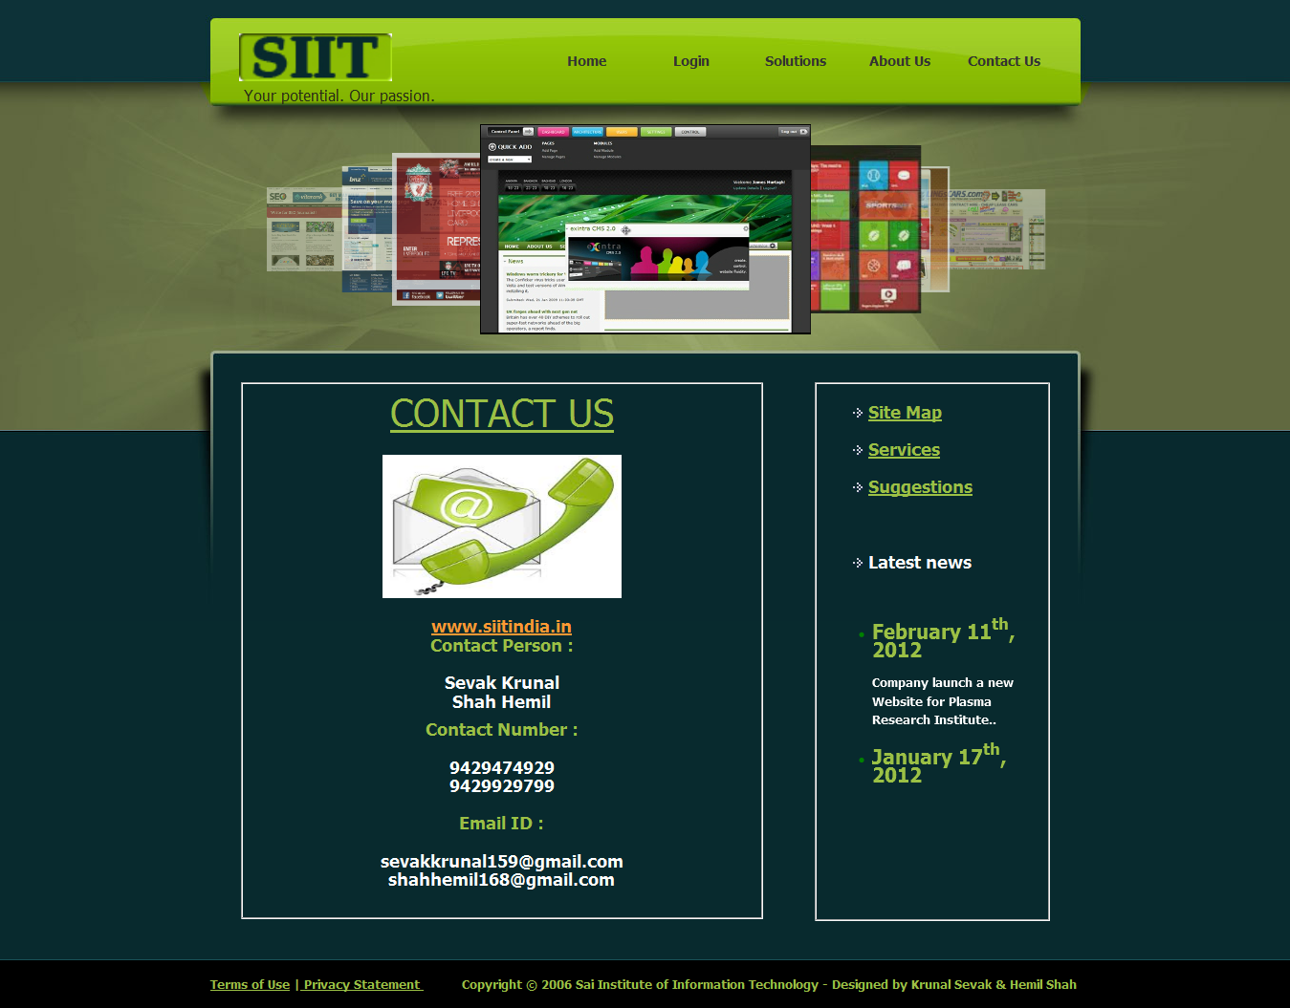
Contact US
Whenever user click on Contact Us then this page will be displayed.
If visitor want to contact us then he/she will be able to view our contact detail.

Slide 36
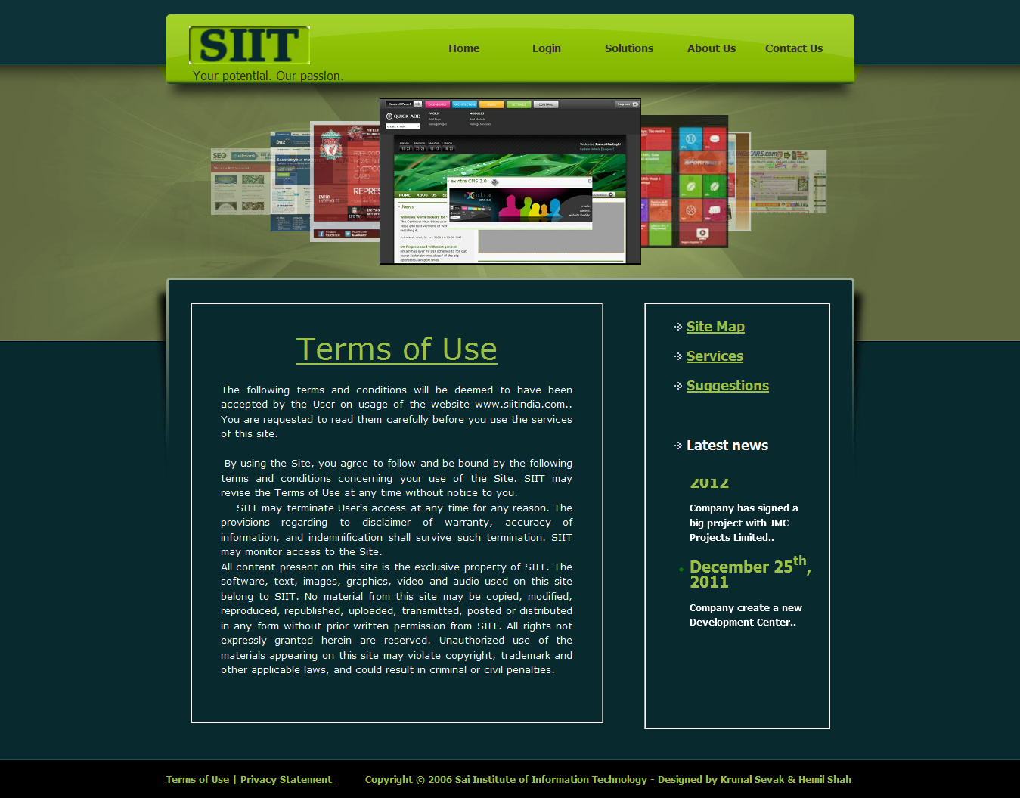
Terms of USE
Whenever user click on Terms of Use then this page will be displayed.
User have to follow all this terms and conditions.

Slide 37

Privacy Policy
Whenever user click on Privacy Policy then this page will be displayed.
Privacy of the user will be maintain in our system.

Slide 38

Solutions
Whenever user click on Solutions then this page will be displayed.
This page contain information about solutions of development of web Portal.

Slide 39

Web Designing
Whenever user click on Web Designing then this page will be displayed.
This page contain information about web designing.

Slide 40

Web SEO
Whenever user click on Web SEO then this page will be displayed.
This page contain information about web search engine optimization.

Slide 41

About Us
Whenever user click on About Us then this page will be displayed.
This page contain information about Sai Institute of Information Technology.

Slide 42
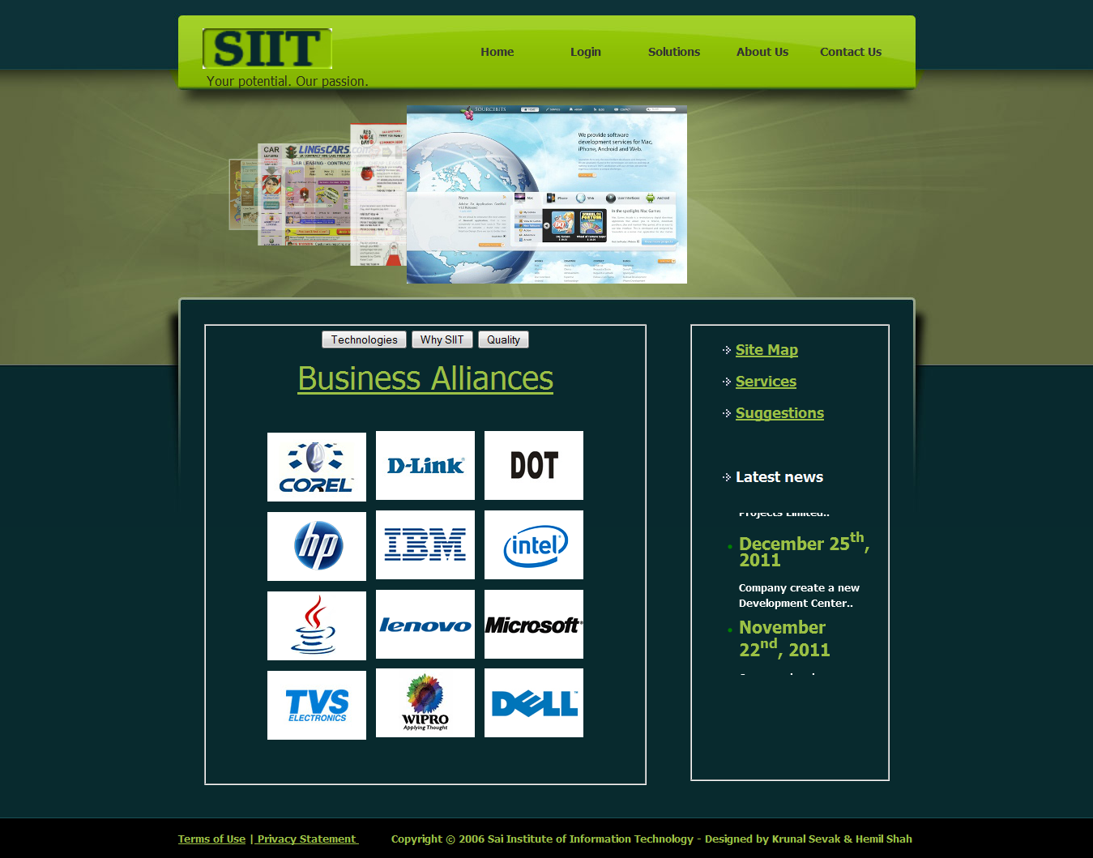
Business Alliances
Whenever user click on Business Alliances then this page will be displayed.
This page contain information about siit’s Business Alliances.

Slide 43
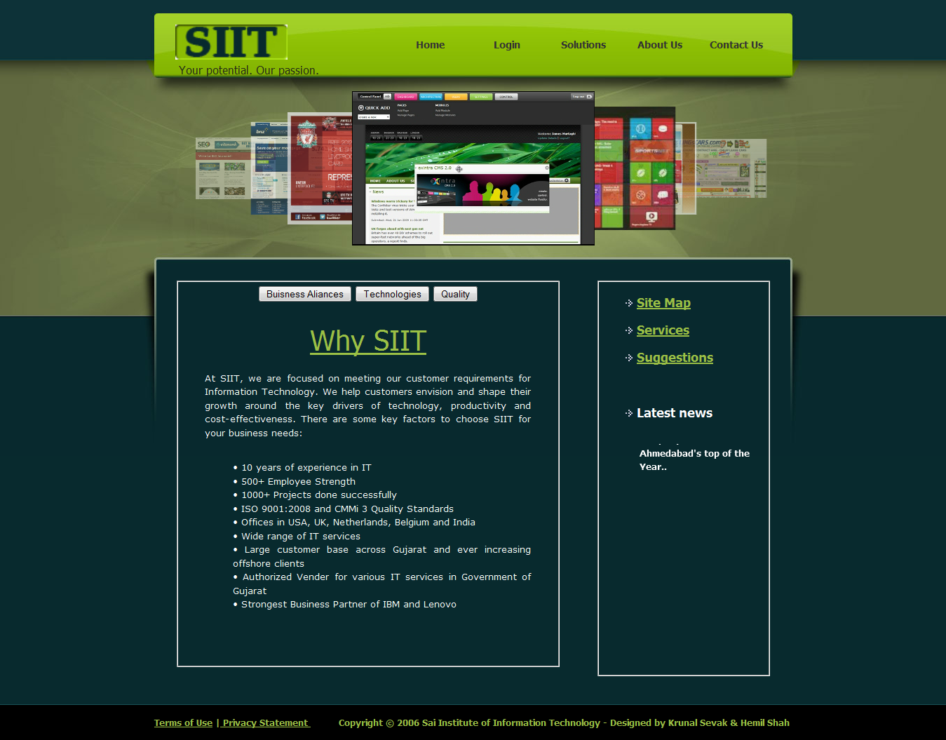
Why SIIT?
Whenever user click on Why SIIT then this page will be displayed.
This page contain information about why user has to trust on SIIT.

Slide 44
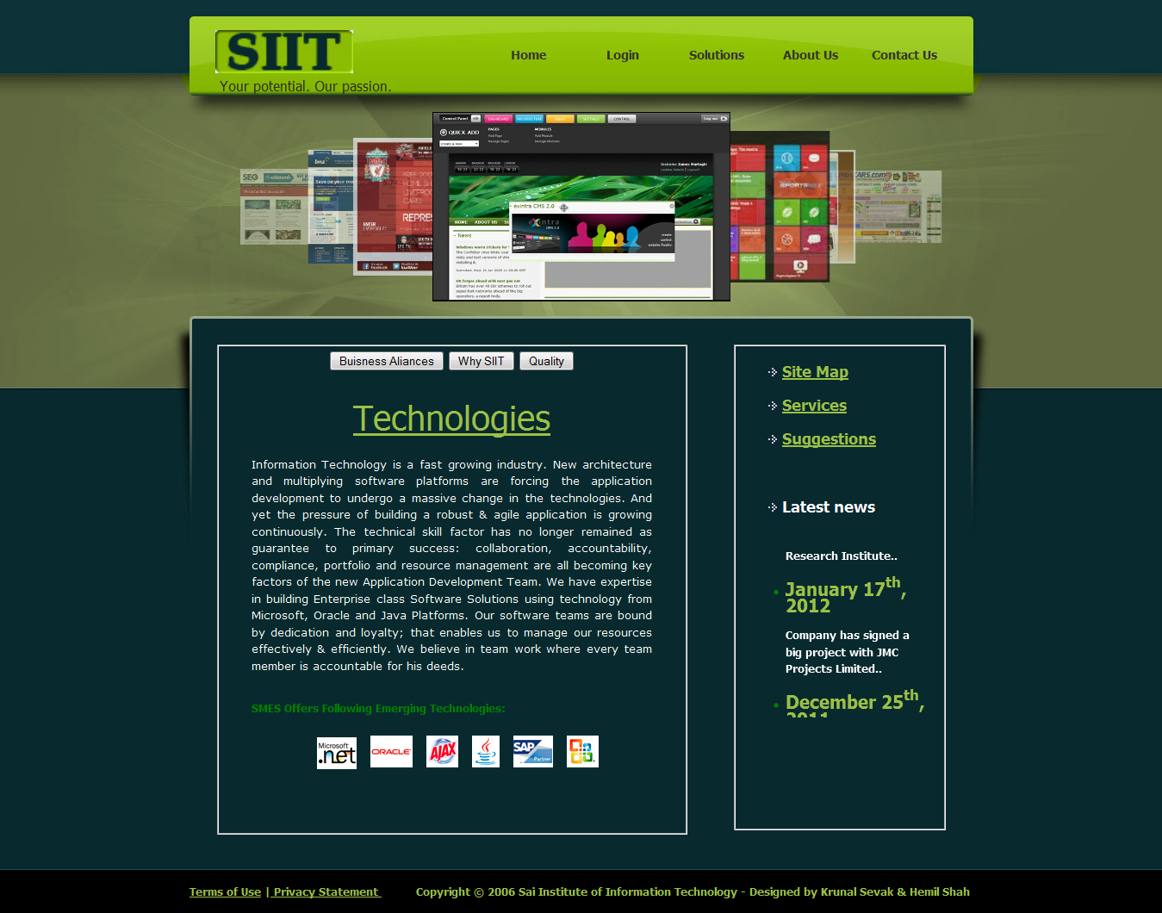
Technologies
Whenever user click on Technologies then this page will be displayed.
This page contain information about Technologies available at SIIT.

Slide 45

Quality
Whenever user click on Quality then this page will be displayed.
This page contain information about qualities of SIIT.

Slide 46

Services
Whenever user click on Services then this page will be displayed.
This page contain information about services provided by SIIT.

Slide 47

PHP Development
Whenever user click on PHP/My SQL then this page will be displayed.
This page contain information about PHP Development in SIIT.

Slide 48

Software Testing
Whenever user click on Software Testing then this page will be displayed.
This page contain information about Software testing methods in SIIT.

Slide 49

JAVA Development
Whenever user click on JAVA Development then this page will be displayed.
This page contain information about JAVA Development in SIIT.

Slide 50

ASP.NET Development
Whenever user click on ASP.NET Development then this page will be displayed.
This page contain information about ASP.NET Development in SIIT.

Slide 51
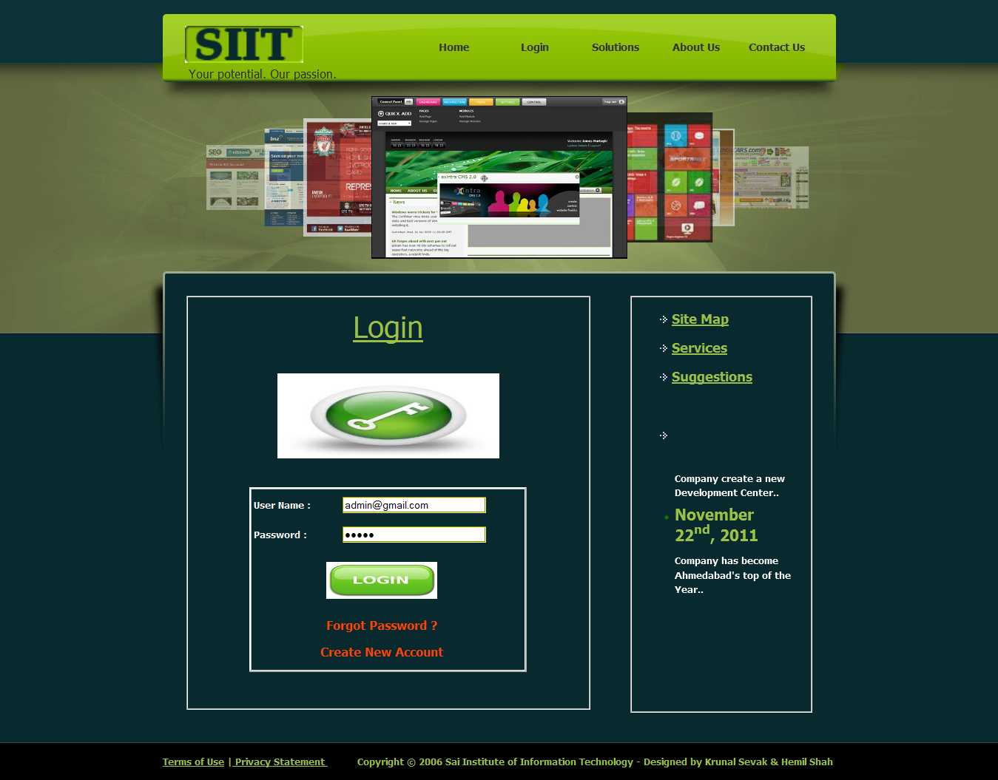
Login
Whenever user click on Login then this page will be displayed.
This page is common login page for all kind of users in SIIT.

Slide 52
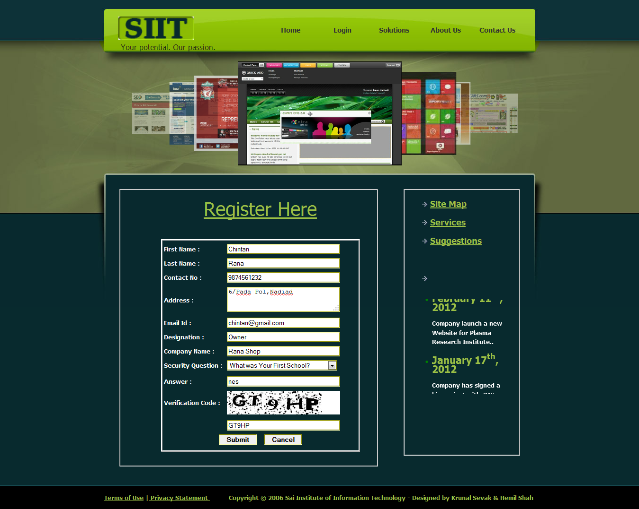
Registration
Whenever user click on Create New Account then this page will be displayed.
From this page visitor can register to become client of SIIT.

Slide 53
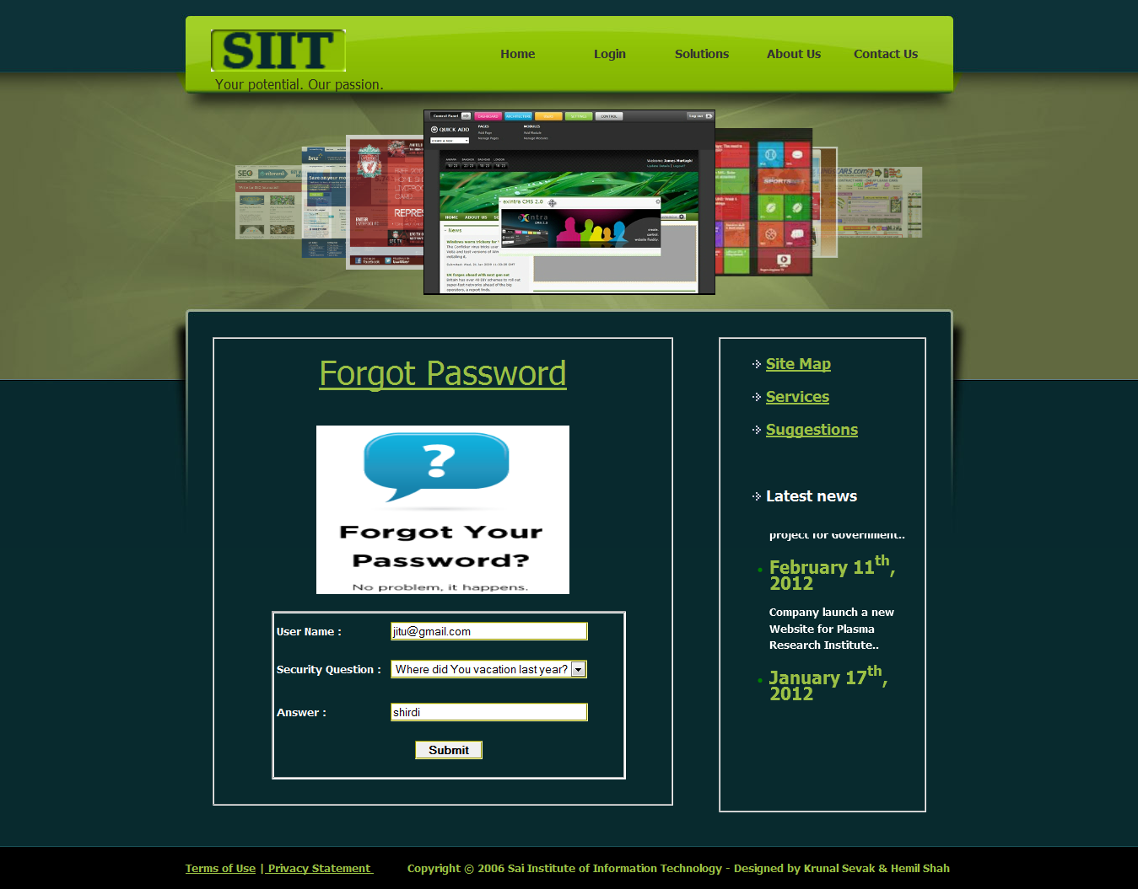
Forgot Password
Whenever user click on Forgot Password then this page will be displayed.
From this page user will get password on their email after filling security answer.

Slide 54
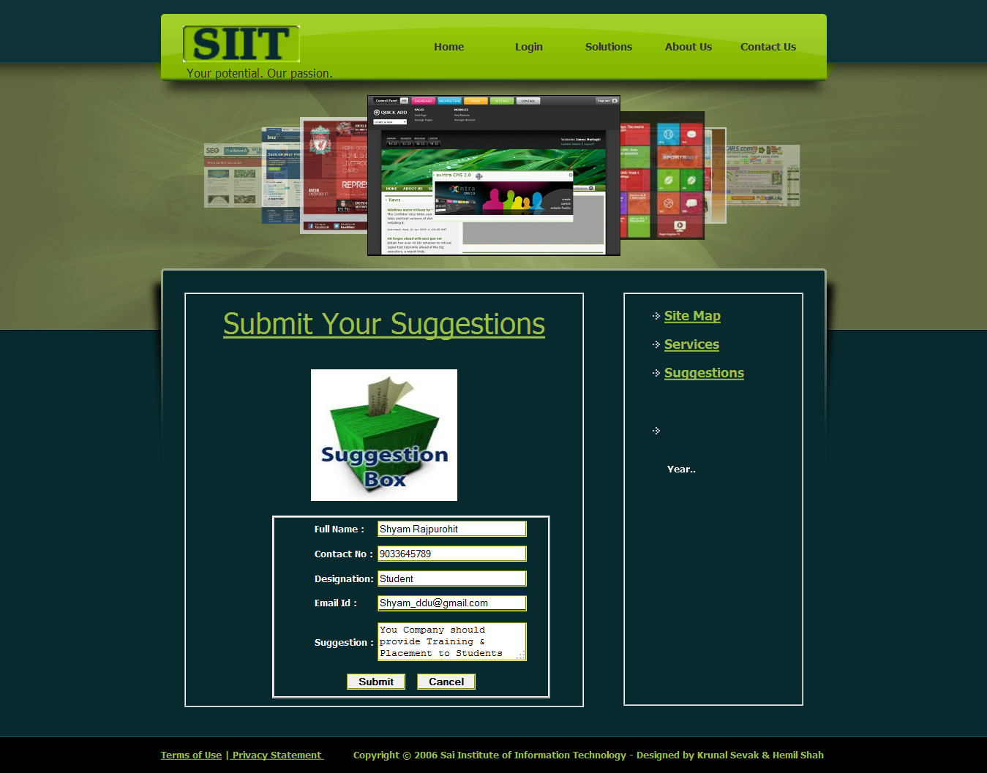
Submit Suggestions
Whenever user click on Suggestions then this page will be displayed.
From this page user can give their suggestions.

Slide 55
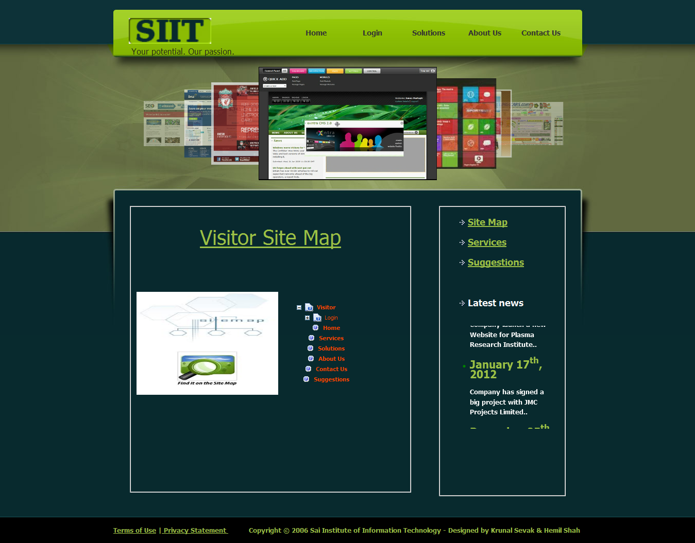
Visitor Site Map
Whenever user click on Site Map then this page will be displayed.
This is site map page, this page contains all links of visitor side.

Slide 56
ADMIN

Slide 57
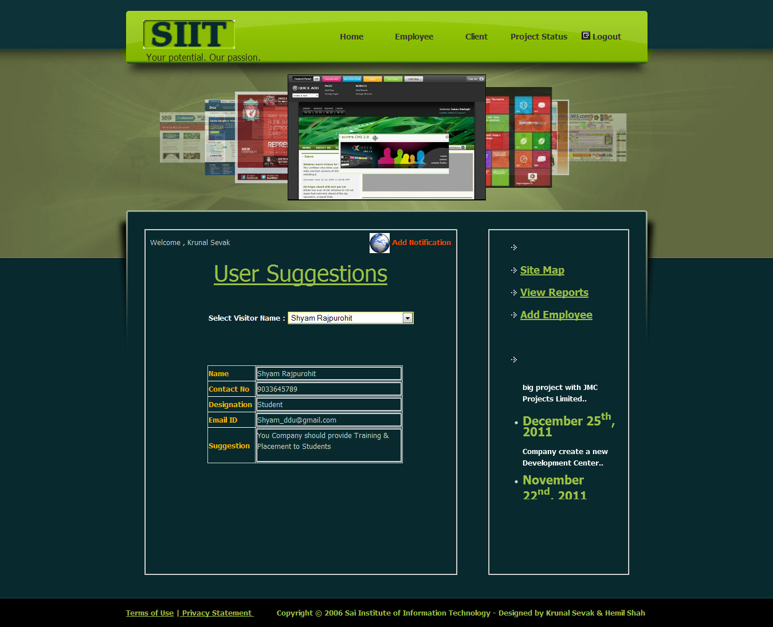
Admin Home
Whenever Admin logins this page will be displayed.
By selecting name from dropdown list admin can see their suggestions.

Slide 58
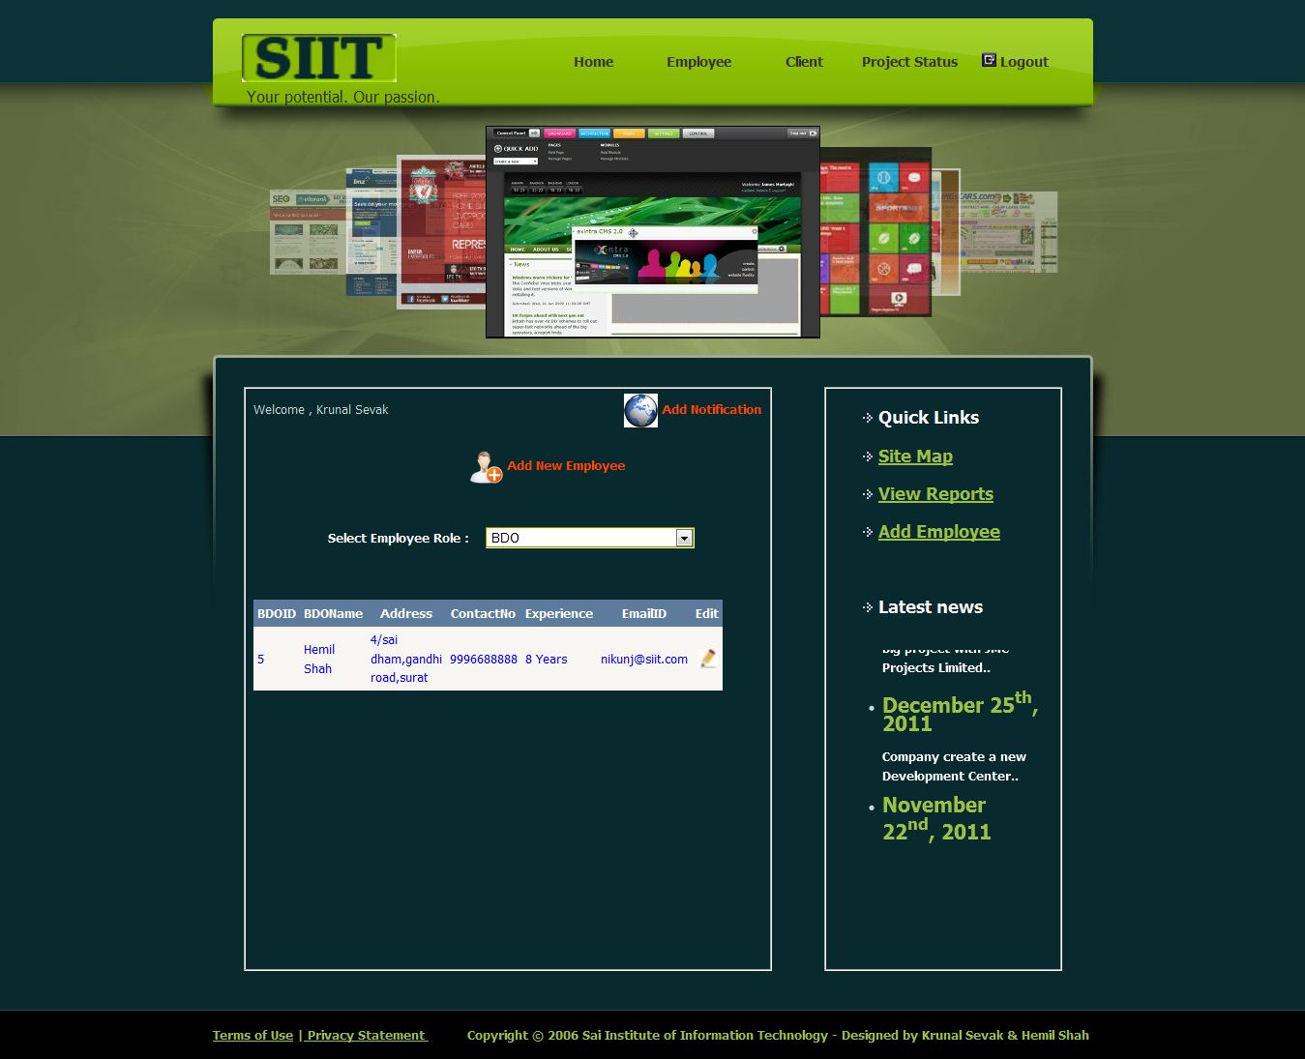
Manage BDO
From this page admin can view the details of BDO.
Admin has to select BDO from the dropdown list.

Slide 59
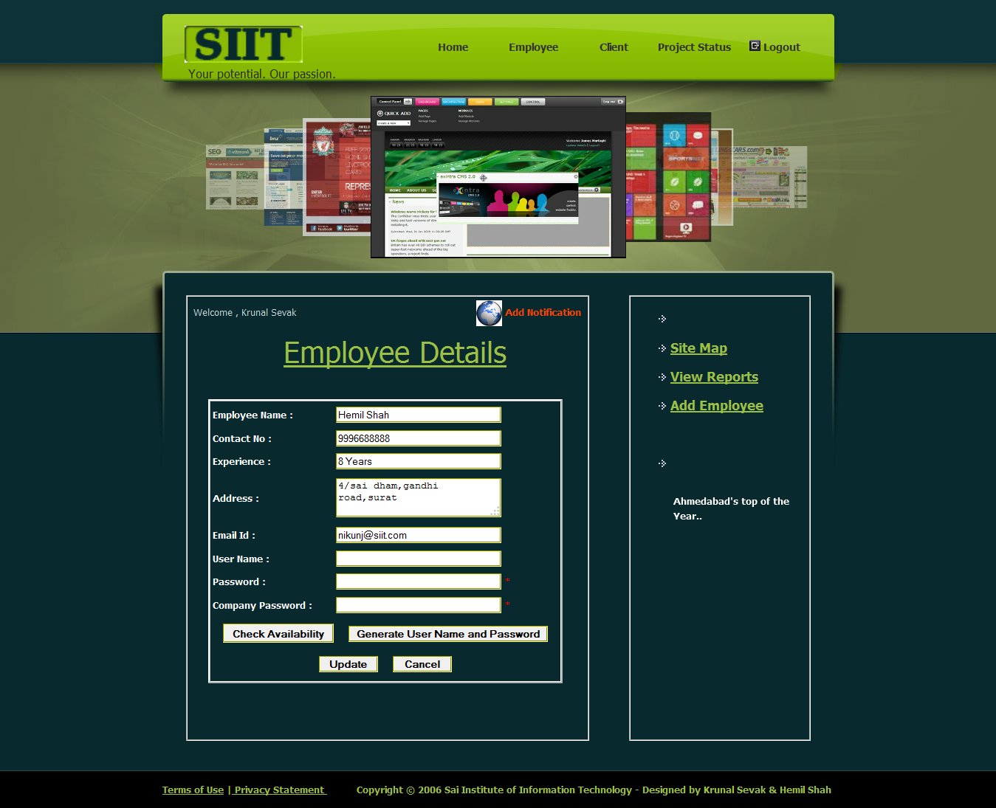
Edit BDO
From this page admin can edit the details of BDO.
Admin has to click on edit from the grid view.

Slide 60
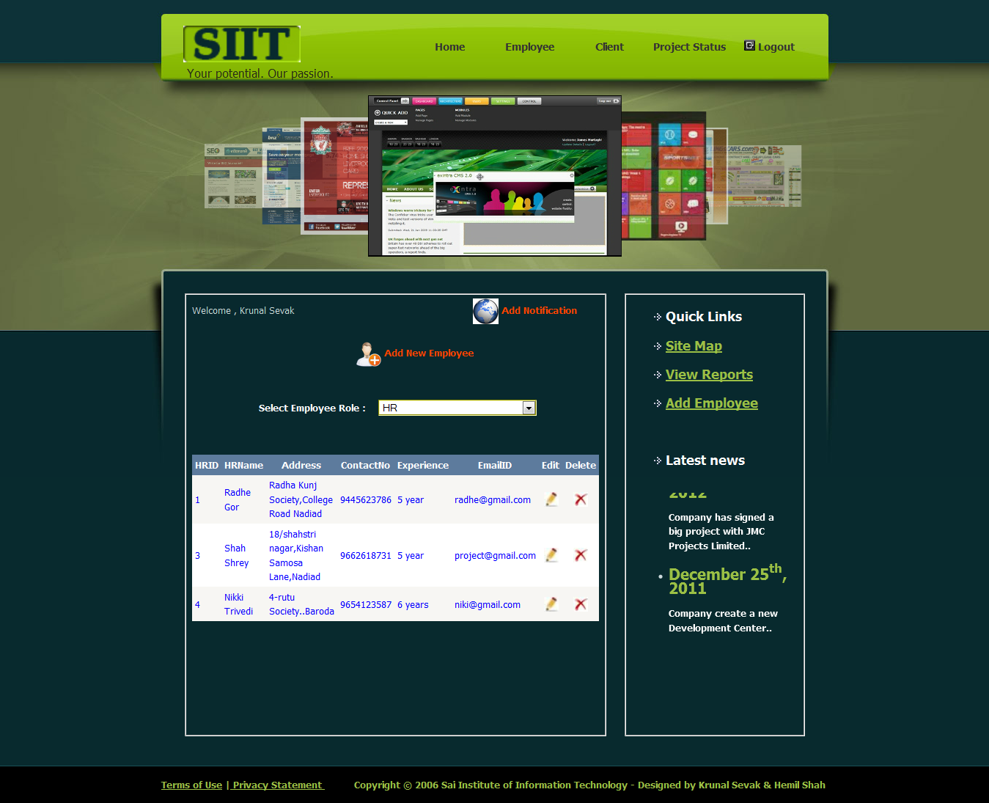
Manage HR
From this page admin can view the details of HR managers.
Admin has to select HR from the dropdown list. Admin also can delete HR.

Slide 61
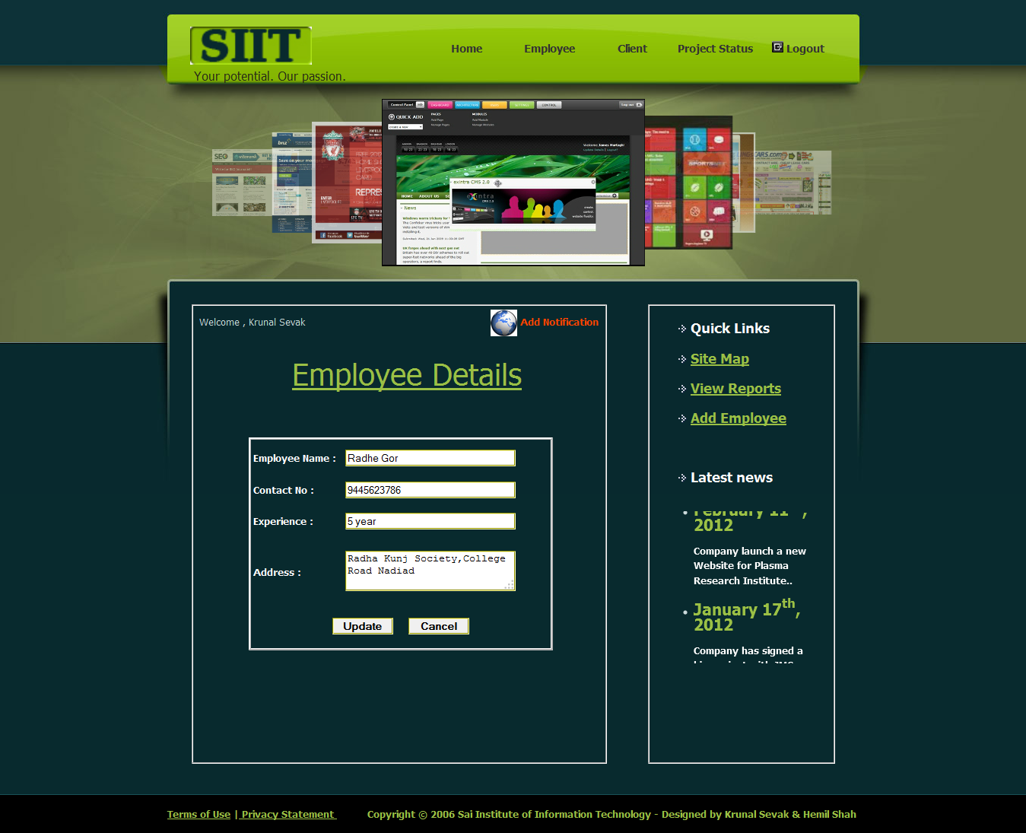
Edit HR
From this page admin can edit the detail of HR manager.
Admin has to click on edit from the grid view.

Slide 62
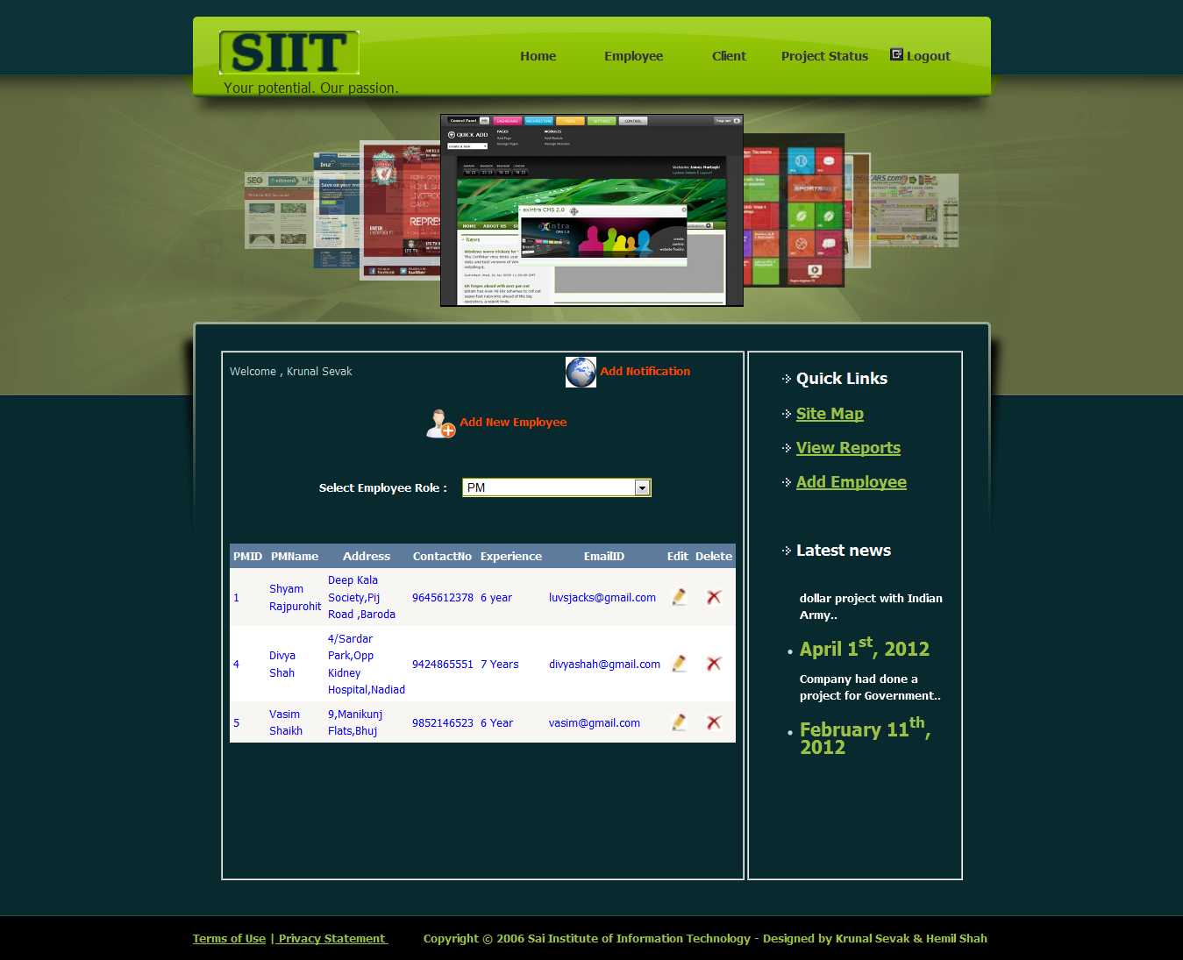
Manage PM
From this page admin can view the detail of Project Managers.
Admin has to select PM from the dropdown list. Admin also can delete PM.

Slide 63
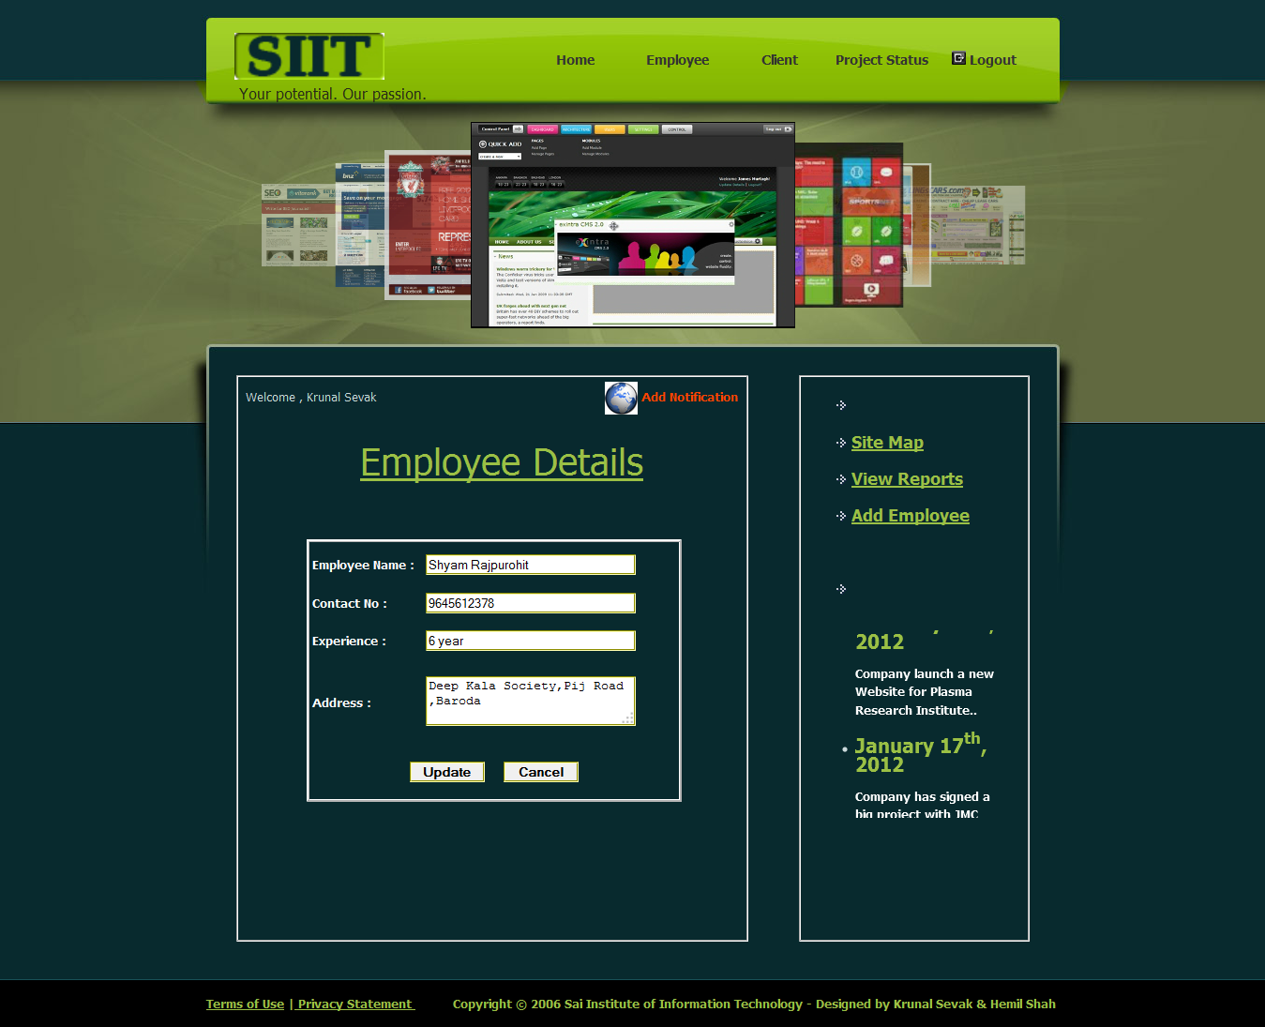
Edit PM
From this page admin can edit the detail of Project Managers.
Admin has to click on edit from the grid view.

Slide 64
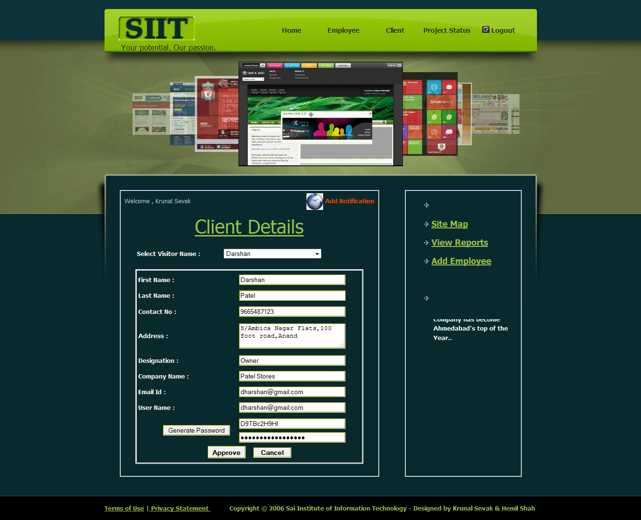
Approve Client
From this page admin can approve the registration requests.
Client will get the mail of approval and also get the password to login.

Slide 65
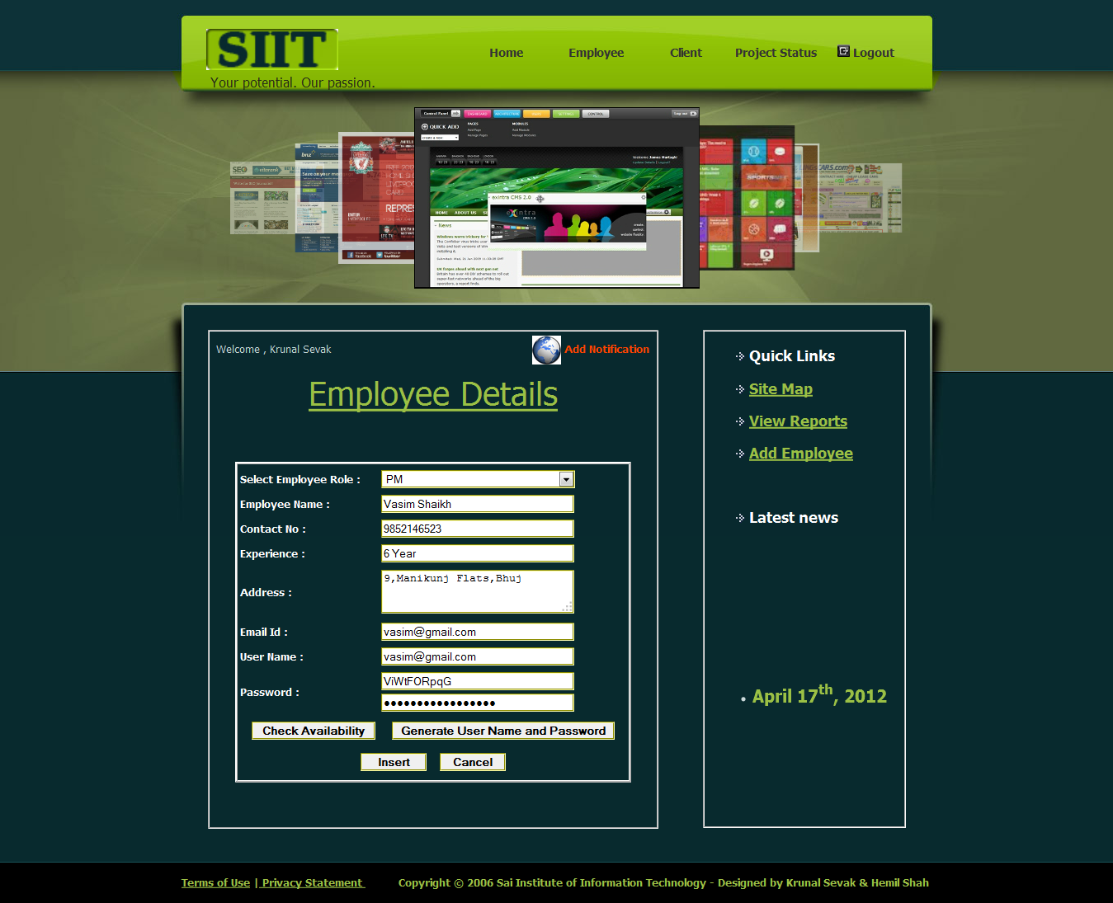
Add Employee
From this page admin can add new employee.
Email ID and password will be generated and send to employee to login.

Slide 66
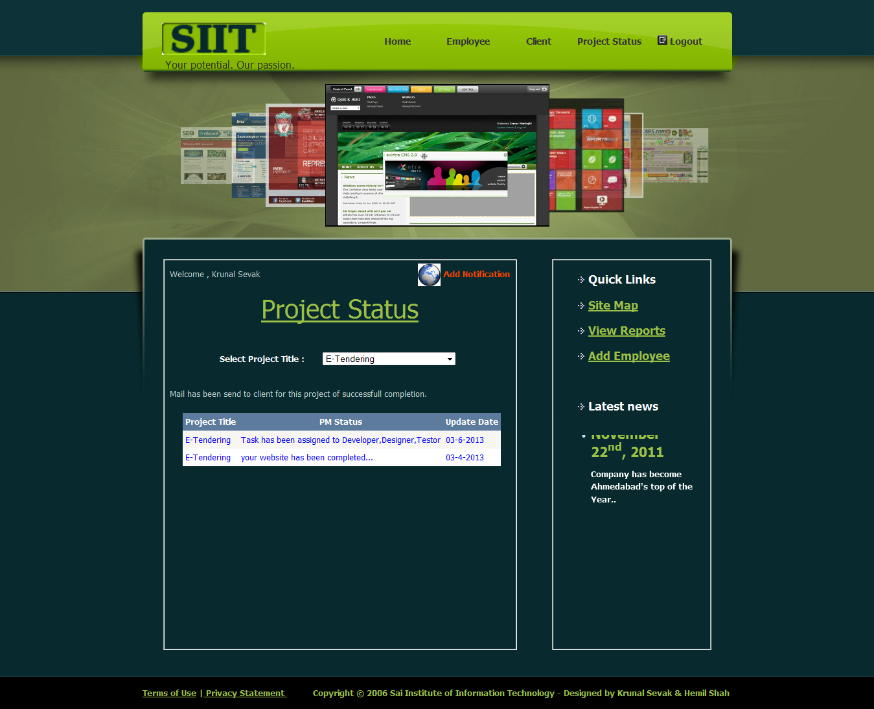
View Project Status
From this page admin can the status of project by selecting project title.
If the Project is completed then that information will also be displayed.

Slide 67
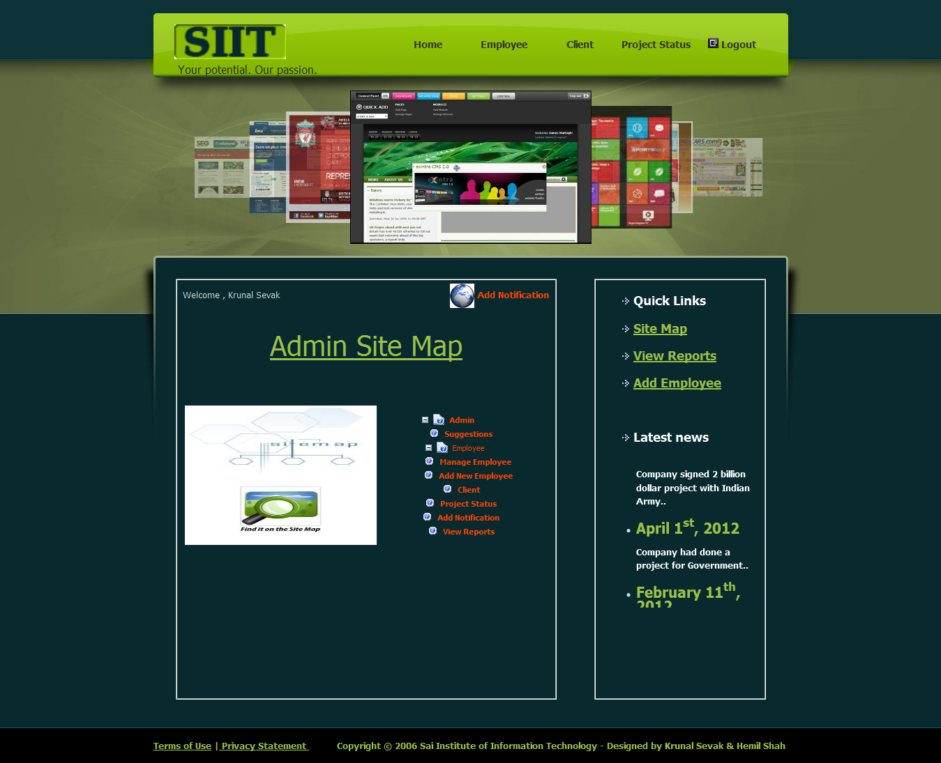
Admin Site Map
Whenever admin click on Site Map then this page will be displayed.
This is site map page, this page contains all links of admin side.

Slide 68
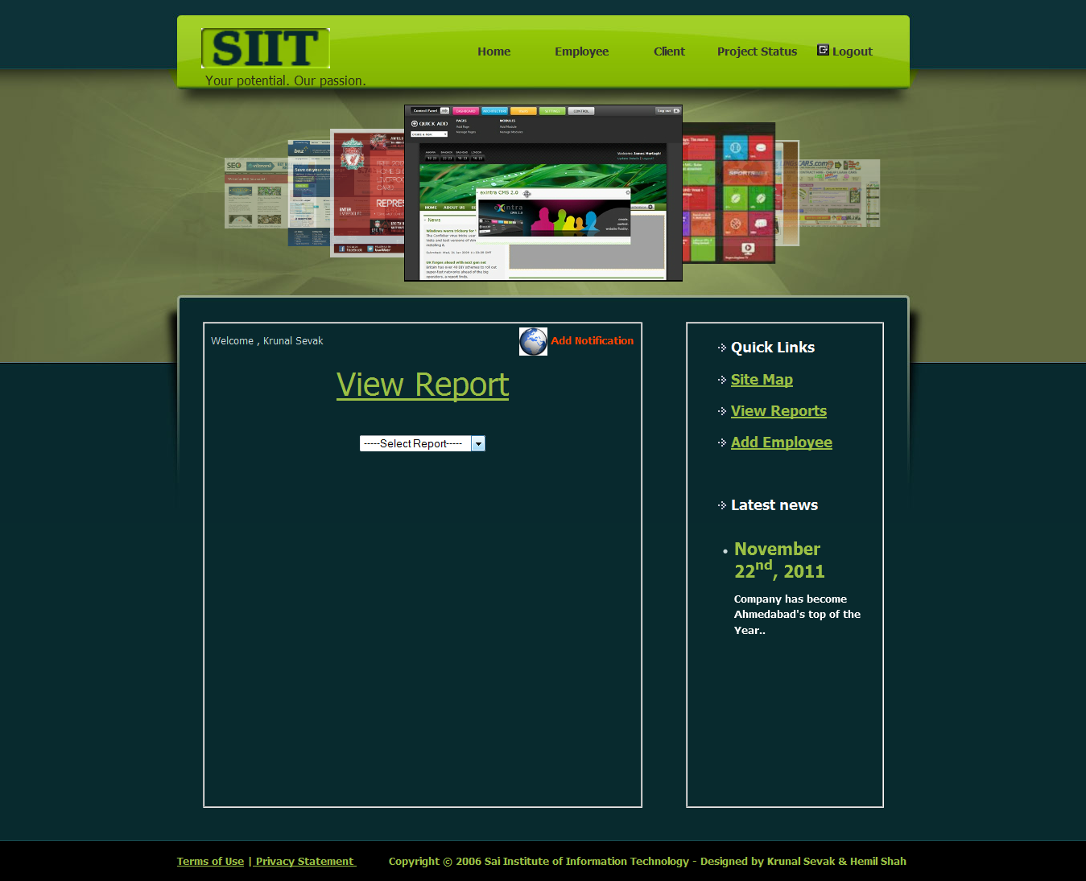
View Report
From this page admin can view the reports generated by the system.
Admin has to select the type of report from the dropdown list.

Slide 69
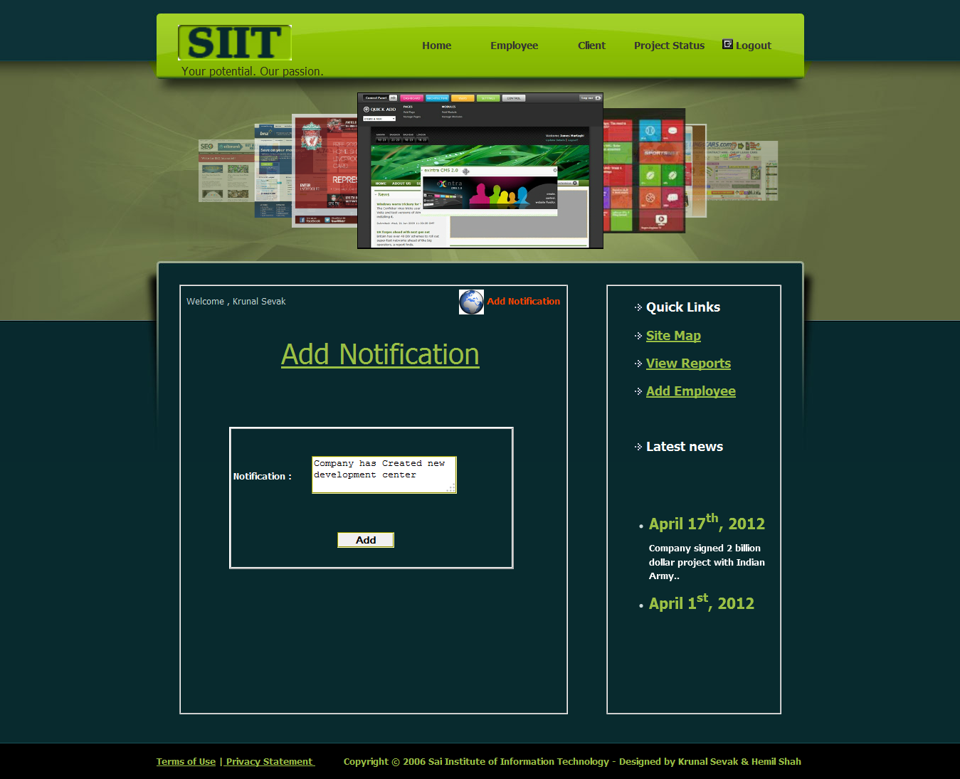
Add Notification
Whenever admin click on Add Notification then this page will be displayed.
Notification will be view by all employees of SIIT.

Slide 70
CLIENT

Slide 71

Client Home
Whenever Client logins this page will be displayed first.
This page contains information about Projects Portfolio.

Slide 72

Software Development Portfolio
Whenever Client click on S/w Development this page will be displayed.
This page contains sample Portfolio of Software Development.

Slide 73

Web Design Portfolio
Whenever Client click on Web Design Portfolio this page will be displayed.
This page contains sample Portfolio of Web Design.

Slide 74

Search Engine Portfolio
Whenever Client click on Search Engine Portfolio this page will be displayed.
This page contains sample Portfolio of SEO.

Slide 75

Technologies
Whenever Client click on Technologies this page will be displayed.
This page contains information about some technologies provided by Microsoft.

Slide 76

AJAX Development
Whenever Client click on AJAX this page will be displayed.
This page contains information about AJAX Development in SIIT.

Slide 77
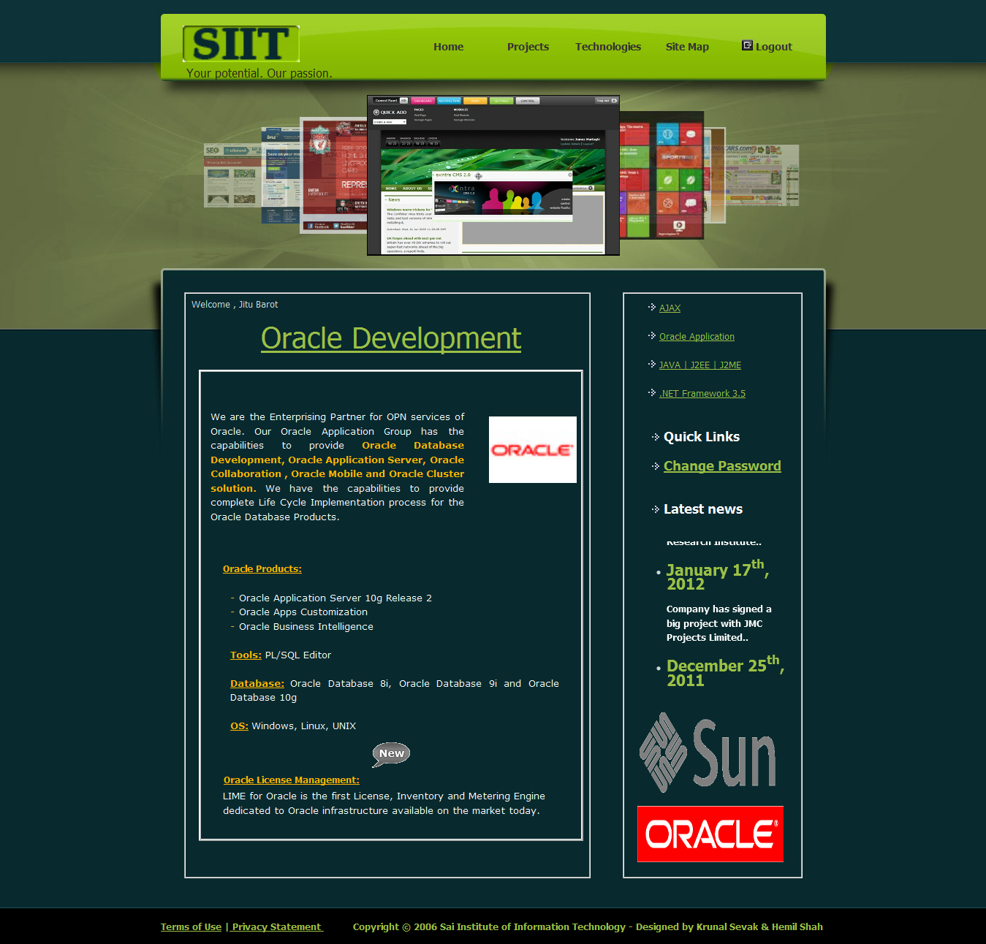
Oracle Development
Whenever Client click on Oracle Development this page will be displayed.
This page contains information about Oracle Development in SIIT.

Slide 78

Java|J2ee|J2ME Development
Whenever Client click on JAVA|J2EE|J2ME this page will be displayed.
This page contains information about JAVA Development in SIIT.

Slide 79

.NET Framework 3.5
Whenever Client click on .NET Framework 3.5 this page will be displayed.
This page contains information about .NET Framework 3.5.

Slide 80

Add New Project
Whenever Client click on Projects this page will be displayed.
Client can add new project. Client have to fill their requirement in this page.

Slide 81

Request to Delete Project
Whenever Client click on Delete Project this page will be displayed.
Client can send request to delete project after his/her project approved.

Slide 82

Submitted Projects
Whenever Client click on Submitted Projects this page will be displayed.
This page contains the detail of projects submitted by Client .

Slide 83

Project Status
Whenever Client click on Project Status this page will be displayed.
This page contains status of project. Client also can download video if added.

Slide 84

Make Payment
Whenever Client click on Make Payment this page will be displayed.
Client will be able to download project after finishing payment.

Slide 85

Download Project
Whenever Client click on Download Project this page will be displayed.
From this page Client can Download their Project.

Slide 86

Client Site Map
Whenever client click on Site Map then this page will be displayed.
This is site map page, this page contains all links of client side.

Slide 87

Change Password
Whenever client click on Change Password then this page will be displayed.
Client can change password by providing current password.

Slide 88
Human Resource Manager

Slide 89

HR Home
Whenever HR logins then this page will be displayed first.
This page contains information about Web Designing.

Slide 90

HR Home
Whenever HR click on Web SEO then this page will be displayed.
This page contains information about Search Engine Optimization.

Slide 91

Manage Employee
Whenever HR click on Employees then this page will be displayed.
HR can view and delete the Designer, Developer and Tester.

Slide 92

Edit Employee Details
Whenever HR click on Edit from grid view then this page will be displayed.
HR can edit the details of Designer, Developer and Tester.

Slide 93

Add Employee
Whenever HR click on Add Employee then this page will be displayed.
HR can add new employee and can mail email-ID and password to employee.

Slide 94

Change Profile
Whenever HR click on Profile then this page will be displayed.
HR can Update his/her profile from this page.

Slide 95

View Requested Project
Whenever HR click on Projects then this page will be displayed.
HR can Approve or UnApprove the project requested by client.

Slide 96

Send Mail
Whenever HR click on UnApprove then this page will be displayed.
HR can send mail the client that his/her project is UnApproved.

Slide 97

Site Map
Whenever HR click on Site Map then this page will be displayed.
This is site map page, this page contains all links of HR side.

Slide 98

Change Password
Whenever HR click on Change Password then this page will be displayed.
HR can change password by providing current password.

Slide 99

Submitted Projects
Whenever HR click on Submitted Projects then this page will be displayed.
This page Contains Approved and UnApproved Project’s detail by HR.

Slide 100

View Notification
Whenever HR click on notification then this page will be displayed.
This page Contains notifications added by admin.

Slide 101
Project Manager

Slide 102

View Requested Projects
Whenever PM logins then this page will be displayed first.
PM can Approve or UnApprove the projects Approved by HR.

Slide 103

Send Mail
Whenever PM click on UnApprove then this page will be displayed.
PM can send mail the client that his/her project is UnApproved.

Slide 104

Scheduling Projects
Whenever PM click on Scheduling then this page will be displayed.
PM can schedule the project by selecting project title.

Slide 105

Task Details
Whenever PM click on Task then this page will be displayed.
PM can view task detail from selecting skill type from dropdown list.

Slide 106

View Task Details
Whenever PM click View Task from grid view then this page will be displayed.
PM can view task detail assigned to particular employee.

Slide 107

Task Allocation
Whenever PM click Assign Task from grid view then this page will be displayed.
PM can assign task detail assigned to particular employee for particular Project.

Slide 108

Change Profile
Whenever PM click on Profile then this page will be displayed.
PM can Update his/her profile from this page.

Slide 109

Site Map
Whenever PM click on Site Map then this page will be displayed.
This is site map page, this page contains all links of PM side.

Slide 110

Update Project Status
Whenever PM click on Project Status then this page will be displayed.
PM can update the status and upload the video if the project is completed.

Slide 111

Change Password
Whenever PM click on Change Password then this page will be displayed.
PM can change password by providing current password.

Slide 112

Submitted Projects
Whenever PM click on Submitted Projects then this page will be displayed.
This page Contains Approved and UnApproved Project’s detail by PM.

Slide 113

View Notification
Whenever PM click on notification then this page will be displayed.
This page Contains notifications added by admin.

Slide 114
BUSINESS DEVELOPMENT OFFICER

Slide 115

Requested Projects
Whenever BDO logins then this page will be displayed first.
BDO can Approve or UnApprove Projects Approved by PM.

Slide 116

Send Mail
Whenever BDO click Approve or UnApprove then this page will be displayed.
BDO can send mail to client that his/her project is Approved/UnApproved.

Slide 117

Project Status
Whenever BDO click on Project Status then this page will be displayed.
BDO can view status of project and also can send mail of status to client.

Slide 118

View Payment
Whenever BDO click on View Payment then this page will be displayed.
BDO can view payment and can change payment status and also can send project.

Slide 119

Projects Requested to Delete
Whenever BDO click on Delete Request then this page will be displayed.
BDO Delete project or Reject the Request to Delete the project by client.

Slide 120

Change Profile
Whenever BDO click on Profile then this page will be displayed.
BDO can Update his/her profile from this page.

Slide 121

Site Map
Whenever BDO click on Site Map then this page will be displayed.
This is site map page, this page contains all links of BDO side.

Slide 122

Change Password
Whenever BDO click on Change Password then this page will be displayed.
BDO can change password by providing current password.

Slide 123

View Notification
Whenever BDO click on notification then this page will be displayed.
This page Contains notifications added by admin.

Slide 124

Submitted Projects
Whenever BDO click on Submitted Projects then this page will be displayed.
This page Contains Approved and UnApproved Project’s detail by BDO.

Slide 125
HR-EMP (DEVELOPER)

Slide 126

Submitted Projects
Whenever Developer logins then this page will be displayed first.
This page Contains Approved and Current Project’s detail.

Slide 127

Task Details
Whenever Developer Click on Tasks then this page will be displayed.
Page Contains detail of Tasks assigned to him/her and he can change status of task.

Slide 128

Update Task Status
Whenever Developer Click Update Task Status then this page will be displayed.
Developer can update the task of particular task assigned to him/her.

Slide 129

View Notification
Whenever Developer click on notification then this page will be displayed.
This page Contains notifications added by admin.

Slide 130

Change Profile
Whenever Developer click on Profile then this page will be displayed.
Developer can Update his/her profile from this page.

Slide 131

Site Map
Whenever Developer click on Site Map then this page will be displayed.
This is site map page, this page contains all links of Developer side.

Slide 132

Change Password
Whenever Developer click on Change Password then this page will be displayed.
Developer can change password by providing current password.

Slide 133
REPORTS GENERATED BY SYSTEM

Slide 134

This report contains list of Projects approved by BDO.
Admin can search by First Name ,Last Name ,Project Title ,Duration ,Expected Cost.

Slide 135

This report contains list of Visitors approved by Admin.
Admin can search by First Name ,Last Name ,Designation ,Company.

Slide 136

This report contains list of Completed Projects.
Admin can search by First Name ,Last Name ,Project Title ,Duration ,Expected Cost.

Slide 137
This report contains list of Completed Projects.
Admin can search by First Name ,Last Name ,Project Title ,Duration ,Expected Cost.

Slide 138

This report contains list of Current Projects.
Admin can search by First Name ,Last Name ,Project Title ,Duration ,Expected Cost.

Slide 139

This report contains list of Employees.
Admin can search by Employee Name ,Skill Set Type , Experience.

Slide 140

This report contains list of Rejected Visitors.
Admin can search by First Name ,Last Name ,Designation ,Company.

Slide 141

This report contains list of UnApproved Projects.
Admin can search by First Name ,Last Name ,Project Title ,Duration ,Expected Cost.

Slide 142

This report contains list of Number of Visitors.
Admin can search by First Name ,Last Name ,Designation ,Company.

Slide 143
TEST CASES

Slide 144
Login Form
No | Test Condition | Input Data | Expected Result | Actual Result
1 | Username, Password, RoleID | admin@gmail.com, sevak, 1=Admin | Go to Admin_Home.aspx with Admin rights. | As Expected
2 | Username, Password, RoleID | nikunj@siit.com, nikunj, 2=BDO | Go to BDO_Home.aspx with BDO rights. | As Expected
3 | Username, Password, RoleID | radhe@gmail.com, radhe, 3=HR | Go to HR_Home.aspx with HR rights. | As Expected
4 | Username, Password, RoleID | vasim@gmail.com, vasim, 4=PM | Go to PM_Home.aspx with PM rights. | As Expected

Slide 145
Login Form
No | Test Condition | Input Data | Expected Result | Actual Result
5 | Username, Password, RoleID | raj@gmail.com, raj, 5=Developer | Go to Developer_Home.aspx with Developer rights. | As Expected
6 | Username, Password, RoleID | jitu@gmail.com, jitu, 6=Client | Go to Client_Home.aspx with Clients rights. | As Expected
7 | Username, Password, RoleID | jitu@gmail.com, 1234, 6=Client | Msg “UserName or Password is Incorrect.” | As Expected
8 | Username, Password, RoleID | nikunj@gmail.com, nikunj 2=BDO | Msg “UserName or Password is Incorrect.” | As Expected

Slide 146
Login Form
No | Test Condition | Input Data | Expected Result | Actual Result
9 | Username, Password, RoleID | admin@siit.com, admin1 1=Admin | Msg “UserName or Password is Incorrect.” | As Expected

Slide 147
Change Password Form
No | Test Condition | Input Data | Expected Result | Actual Result
1 | Old Password, New Password, Confirm Password | Mcvb67Rasd, jitu, jitu | Msg “Change Password Successfully.” | As Expected
2 | Old Password, New Password, Confirm Password | sevak, 1234, 1234 | Msg “Old Password is Wrong.” | As Expected
3 | Old Password, New Password, Confirm Password | jitu, 1234, 4321 | Msg “Password Mis-Match.” | As Expected

Slide 148
Registration Form
No | Test Condition | Input Data | Expected Result | Actual Result
1 | Client Name Check | Faculty / Student / Contact Person Name | The Name should be considering Alphabets only. If the name entered is not proper, then the system should prompt the user that the entered “Name is not Valid.” | As Expected
2 | E-mail address Check | Email Address | If a proper email address is not entered, then the system should prompt the user that the e-mail address is not valid. | As Expected

Slide 149
Registration Form
No | Test Condition | Input Data | Expected Result | Actual Result
3 | Mobile No. Check | Mobile Number | The Mobile number should be considering numeric and of length 14 only. If the number entered is not proper, then the system should prompt the user that the entered “Number is not Valid.” | As Expected
4 | Verification Code | Enter Captcha Code | The Verification Code Should be Same as Captcha code . If the code is not proper, then the system should prompt the user that the “verification code is Incorrect”. | As Expected

Slide 150
Scopes and Limitations
The web based application is made reliable and globally accessible by user and it’s very secure to user. The main advantage is that only authenticated clients can Login to and can view Personal details of Site, so it’s very clear that unauthorised persons can not missuse it.
Internet based application
Integrate with any existing online application
Dynamically make changes.
In future new technology can be applied.

Slide 151
Cont…..
The usefulness of any system depends upon some of the basic things which are:
Portability
Reliability
Maintainability
Satisfaction Of User Requirements
User Friendliness
All the objectives that had been charted out in the initial phases were achieved successfully.

Slide 152
Cont…..
System Features:
System satisfies all the requirements for which the company developed the system. System has strong security. System is fully GUI based. It is easy to operate and user-friendly. Platform includes the in-built back-up and recovery facility.
Working on the project was a good experience. Working together in teams helped us to communicate better. We understand the importance of planning and designing as a part of software development.
The concept of peer-reviews helped to rectify the problems as and when they occurred and also helped us to get some valuable suggestions that were incorporated by us. Developing the project has helped us to gain some experience on real time development procedures.

Slide 153
Cont…..
System Connectivity
No data duplication
No Paper Work Required
Time Efficient
User friendly environment
Data security and reliability
Fast retrieval
Easy performance check

Slide 154
Cont…..
The general objectives are:
Maintain project details.
Maintain client details.
Maintain employee details.
Maintain task details of each project.
Update each task status of project.
Update project status.

Slide 155
Cont…..
Limitations of the System are:
Client will be able to watch the project after completion of project.
Tool is running only on Microsoft platform.
Problem may be occurring in the installation of project.
Training of client becomes difficult.

Slide 156
Future Expansion
The application developed by us is very flexible and scalable due to .NET and SQL Server environments. All the services provided by the application are implemented as object. New object can be added as and when required to provide additional functionality.
.NET is an ideal programming language for developing sophisticated professional application for Microsoft Windows. It makes use of Graphical User Interface for creating robust and powerful application. This feature makes an easier to comprehend things in a quicker and easier way. Features such as easier comprehensive, user-friendliness, faster application development and many other aspects such as internet features make .NET an interesting toll to work with .We can also add these features in system.

Slide 157
Cont…..
All the services provided by the application are implemented as object. New object can be added as and when required to provide additional functionality like,
We can provide online payment facility to client.
We can provide online chat facility to visitor and client.
We can arrange online Video Conference to deal and Install the project.
We can provide online User Manual to client.
We can provide Facility of online web Service.

Slide 158
References and BiblioGraphy
Reference Books
Wrox.Professional.ASP.NET 2.0 - Nov.2005
OReilly.Learning.ASP.NET 2.0 with AJAX - Sep.2007
Reference Sites
http://www.asp.net/
http://msdn.microsoft.com/
http://www.w3schools.com/
http://www.wikipedia.com/
http://www.google.com/
http://www.stackoverflow.com/

Slide 159
THANK YOU

